Slide 1

Project Presentation
Online Learning Application
Academic Year 2021-2022
Prof. GATTI NICOLA
Aygalic Jara
Christopher Volpi
Giulia Montani
Luca Mainini
Roberta Troilo

Slide 2
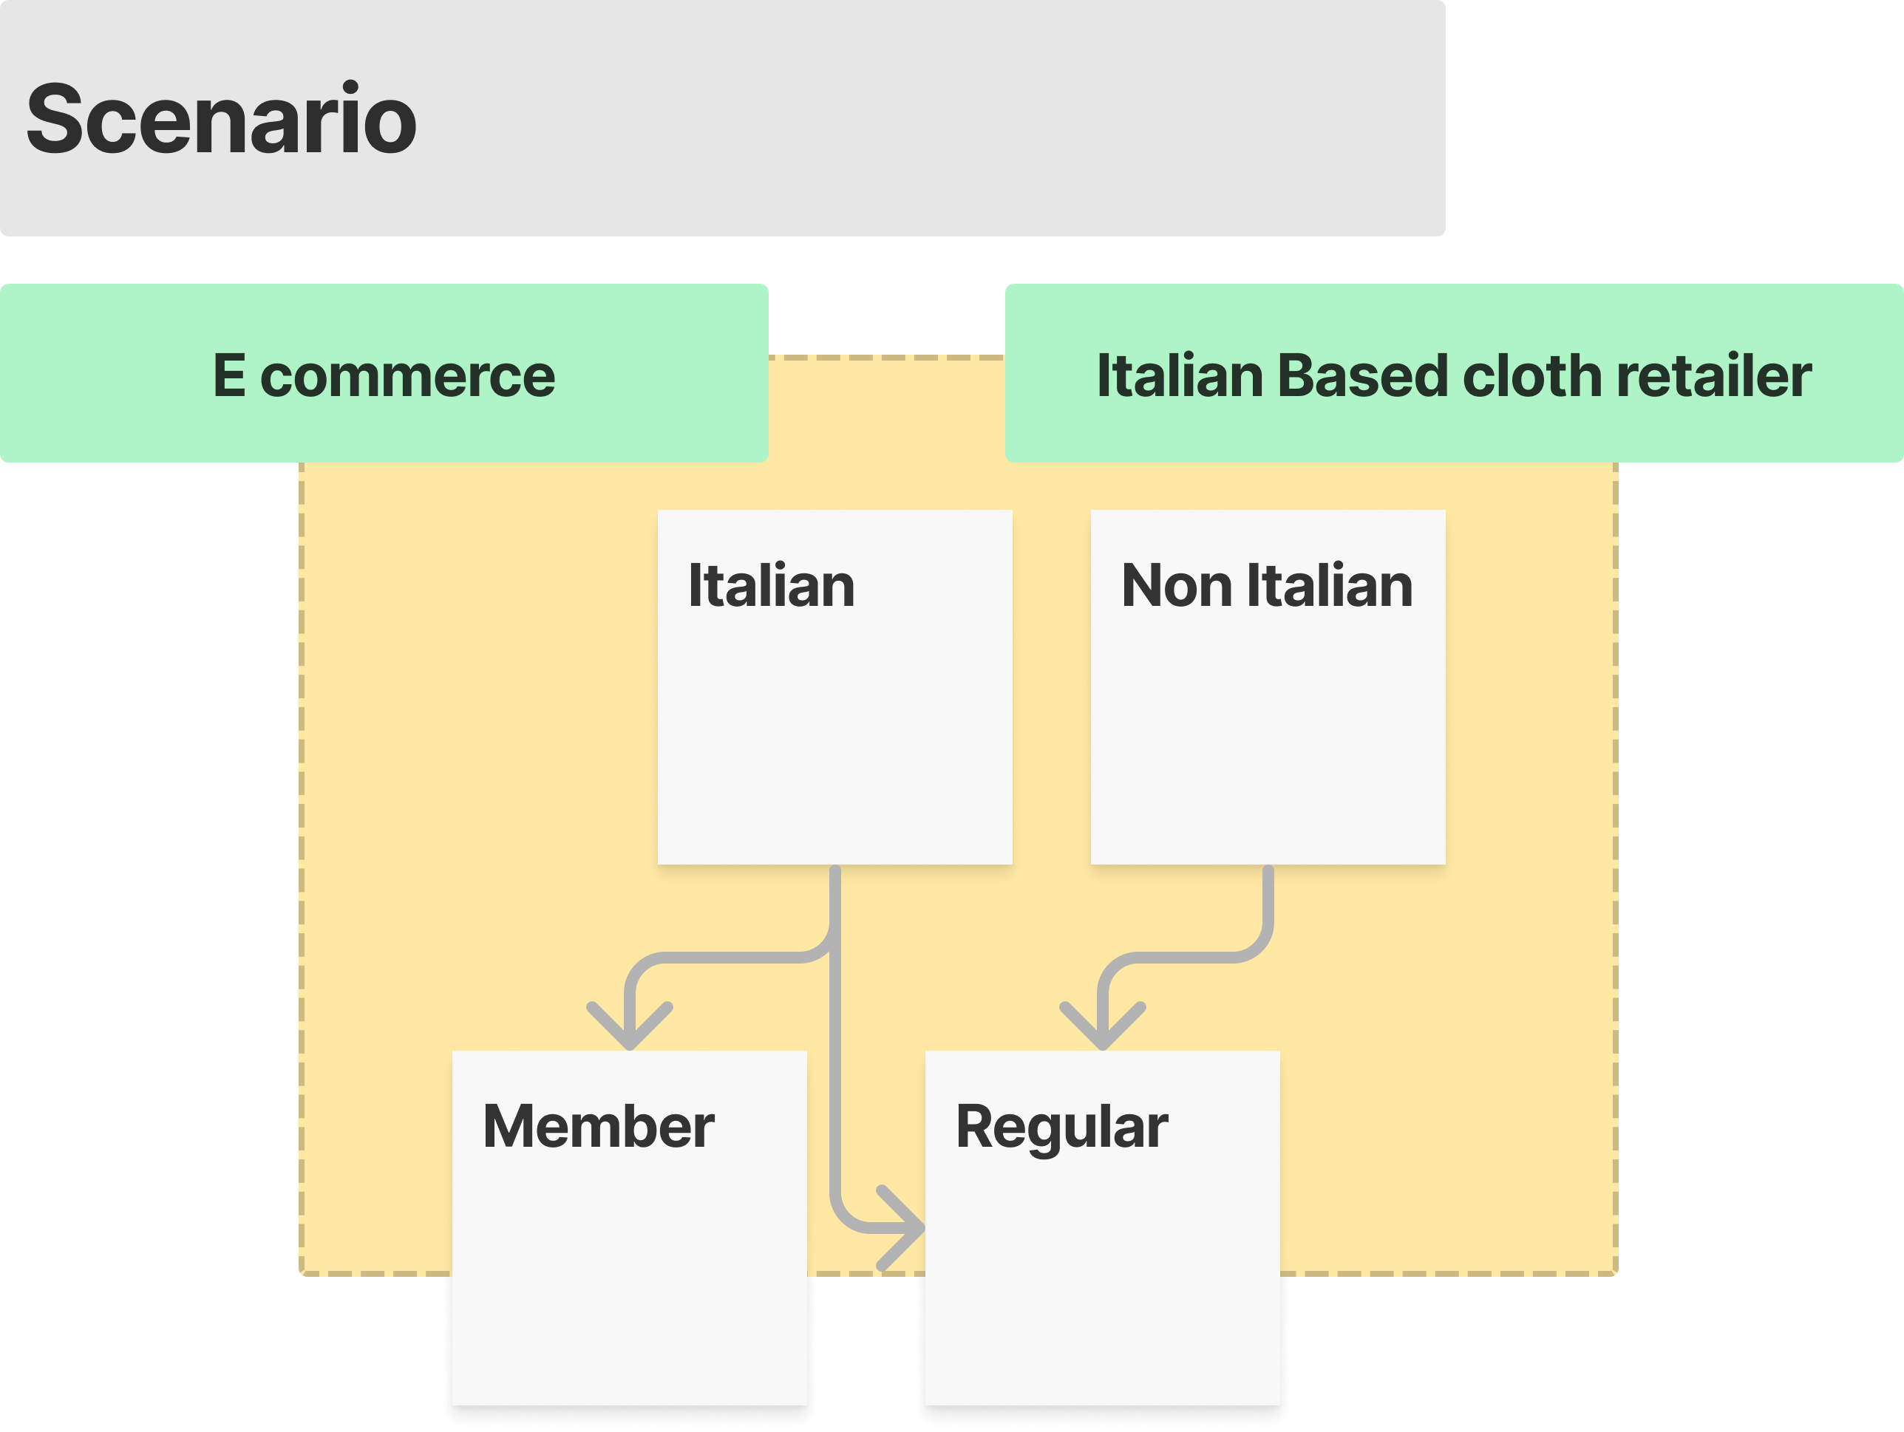


Slide 3

1 – Environment
Notes:
The environment we realized has the following architecture:

Slide 4
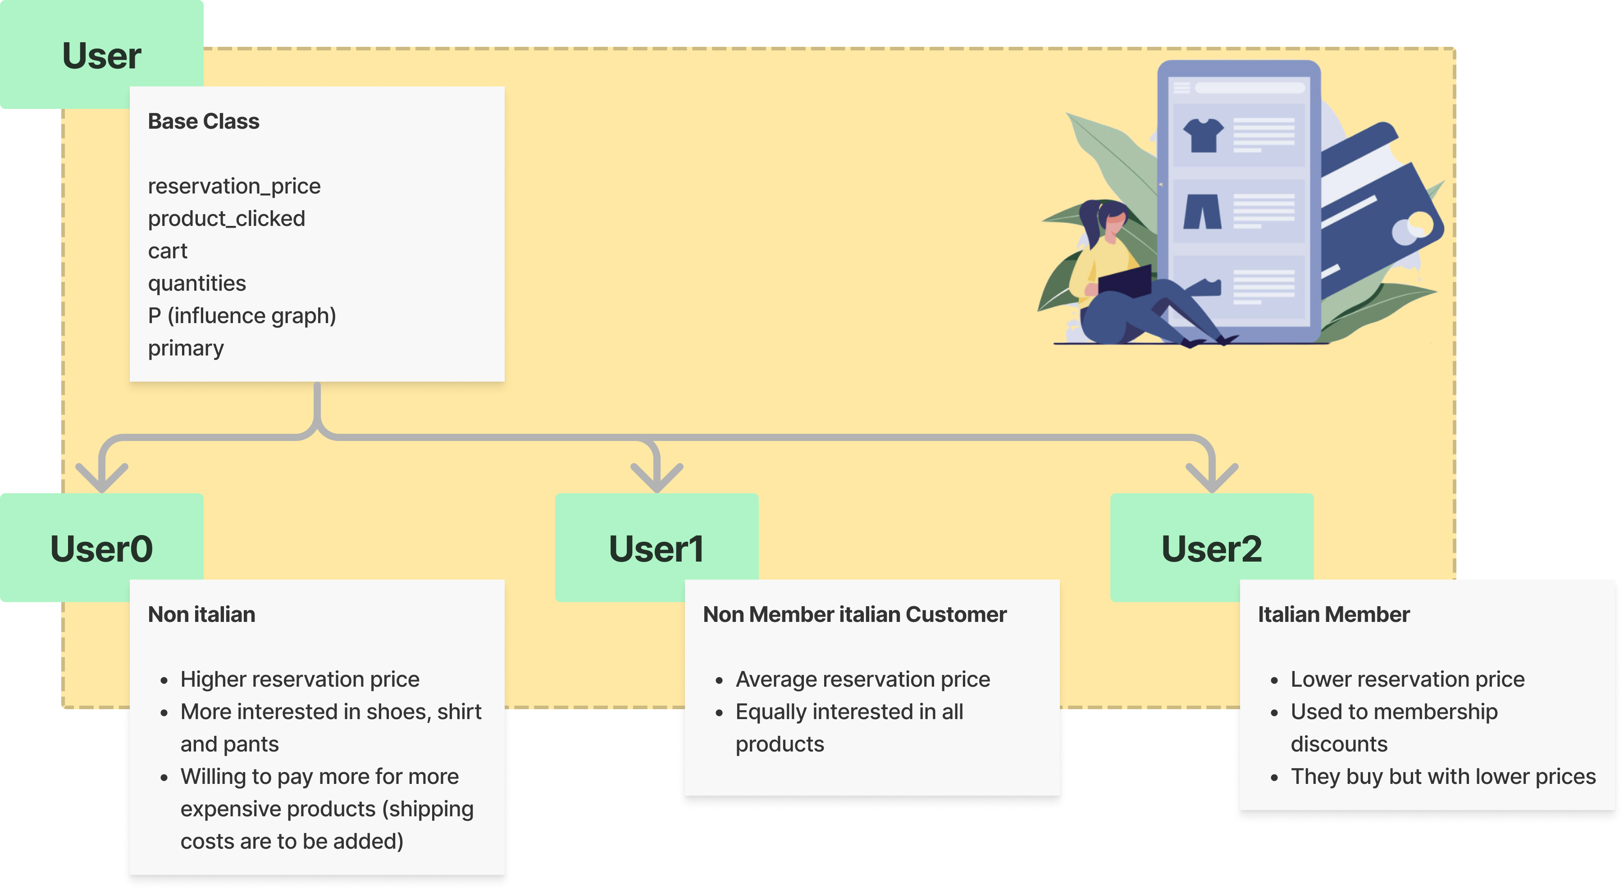
Notes:
For the description of the user, try to do something more visual

Slide 6
User Distribution*
*based on previous year’s data

Slide 7

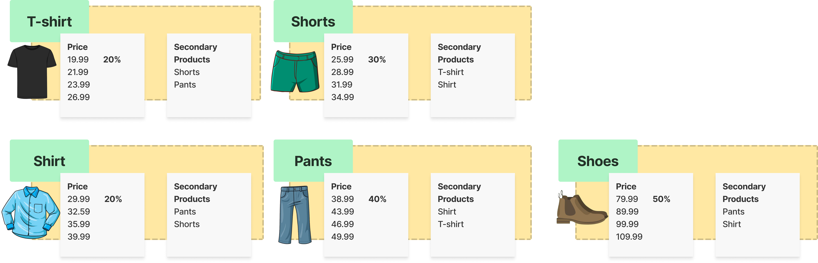
Product, Pricing & Suggestion
Margin

Slide 8

Suggestion Interface

Slide 9
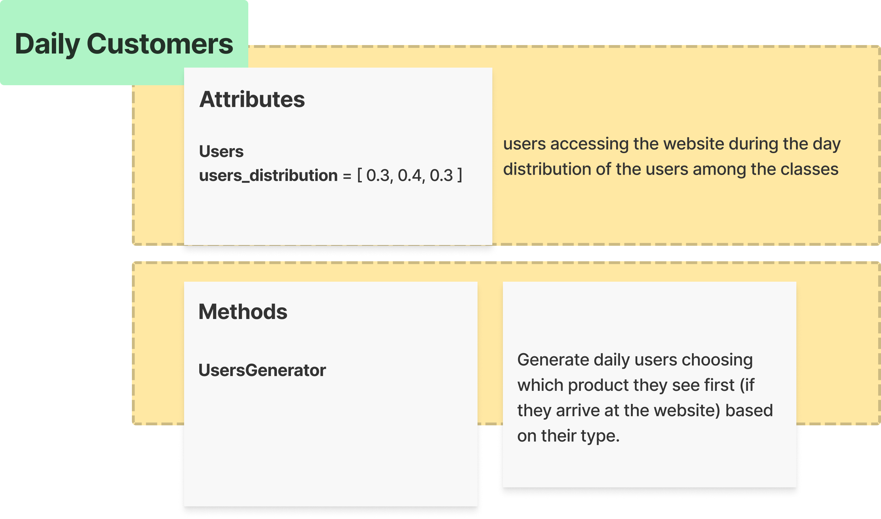

Slide 10
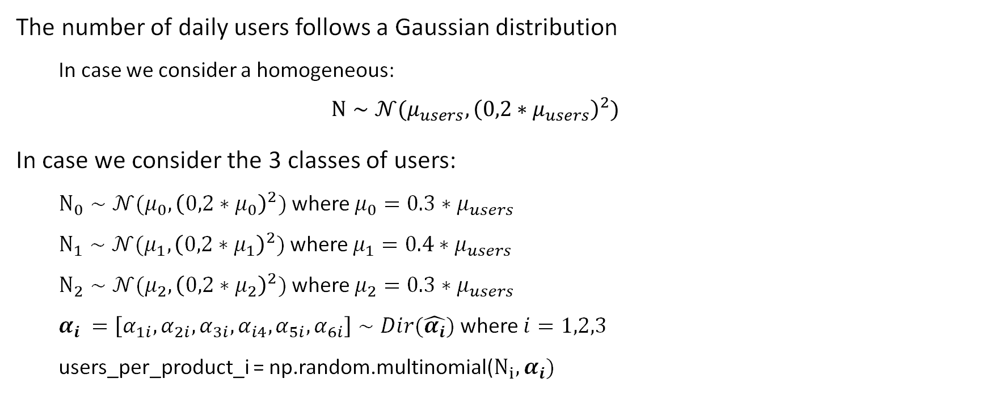
Hypothesis on User Distribution
The number of daily users follows a Gaussian distribution
In case we consider a homogeneous:
$$N∼𝒩(μ_{users},{\left(0,2∗μ_{users}\right)}^{2})$$
In case we consider the 3 classes of users:
$N_{0}∼𝒩(μ_{0},{\left(0,2∗μ_{0}\right)}^{2})$ where ${μ_{0}=0.3∗μ}_{users}$
$N_{1}∼𝒩(μ_{1},{\left(0,2∗μ_{1}\right)}^{2})$ where ${μ_{1}=0.4∗μ}_{users}$
$N_{2}∼𝒩(μ_{2},{\left(0,2∗μ_{2}\right)}^{2})$ where ${μ_{2}=0.3∗μ}_{users}$
$α_{i} =\left[α_{1i},α_{2i},α_{3i},α_{i4},α_{5i},α_{6i}\right]∼Dir(\hat{α_{i}})$ where $i=1,2,3$
users_per_product_i = np.random.multinomial($N_{i},α_{i})$
Notes:
Every day, there is a random number of potential new customers (returning customers are not considered here). In particular, every single customer can land on the webpage in which one of the 5 products is primary or on the webpage of a product sold by a (non-strategic) competitor. Call 𝛼_i the ratio of customers landing on the webpage in which product Pi is primary, and call 𝛼_0 the ratio of customers landing on the webpage of a competitor. In practice, you can only consider the 𝛼 ratios and disregard the total number of users. However, the 𝛼 ratios will be subject to noise. That is, every day, the value of the 𝛼 ratios will be realizations of independent Dirichlet random variables.

Slide 11
Daily Customers - UsersGenerator
def UsersGenerator(self, number_users, fixed_alpha, fixed_weights, binary_features): """Generate daily users choosing which product they see first (if they arrive at the website) based on their type. :param number_users: average number of potential users in a day :type number_users: int :param fixed_alpha: 1 if alpha is fixed (uniformly distributed over the products) :type fixed_alpha: bool :param fixed_weights: 1 if graph weights are fixed :type fixed_weights: bool :param binary_features: 1 if we distinguish between user's types, 0 if not :type binary_features: bool

Slide 12
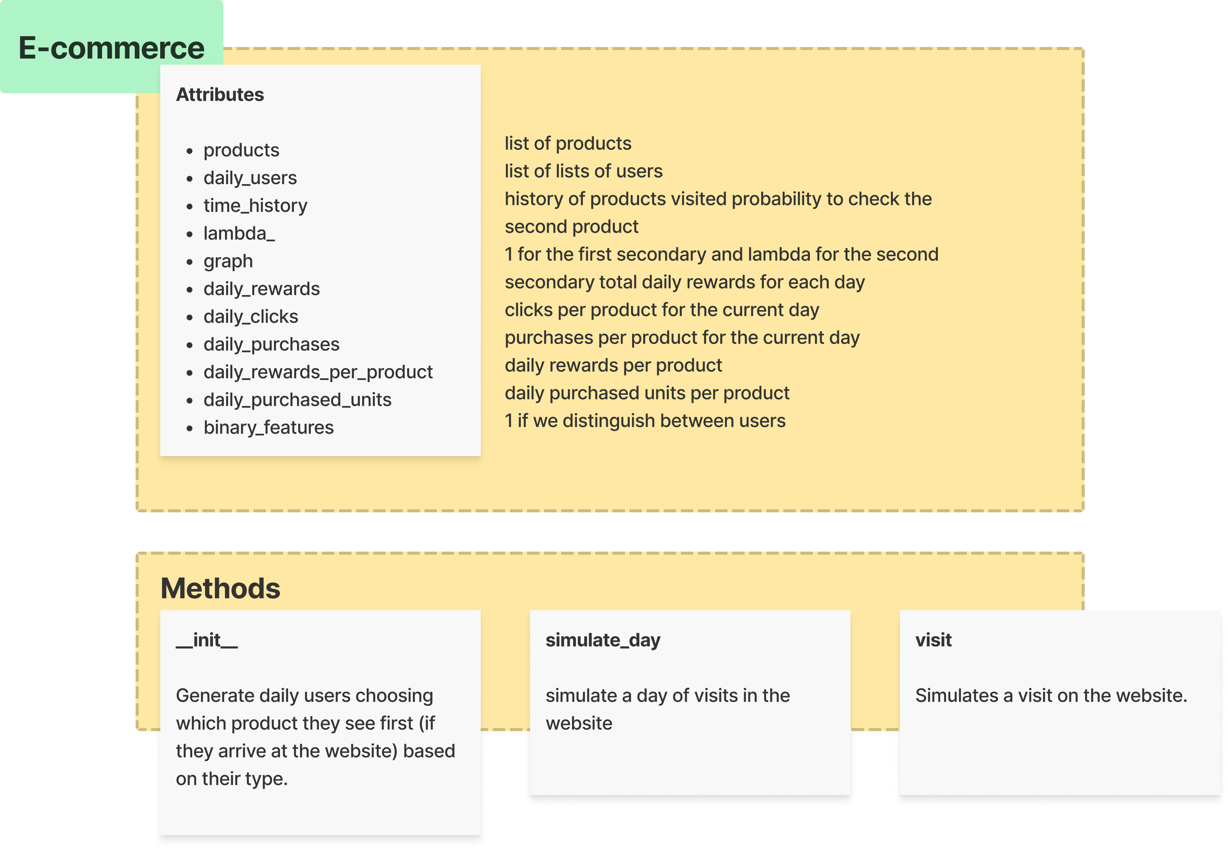

Slide 13
E-commerce
def __init__(self, binary_features=1): """ E-commerce class. :param binary_features: 1 if we distinguish between users """ # list of products self.products = [] # list of lists of users self.daily_users = [] # dataset with the history of products visited by each user in each day self.time_history = [] # probability that the user checks the second product self.lambda_ = 0.5 # weight of the graph: 1 for the first secondary and lambda for the second secondary self.graph = np.array( [[0., self.lambda_, 0., 1., 0.], [1., 0., 0., self.lambda_, 0.], [0., 1., 0., self.lambda_, 0.], [0., self.lambda_, 1., 0., 0.], [1., 0., 0., self.lambda_, 0.]]) # list of the total daily rewards for each day self.daily_rewards = [] # clicks per product for the current day self.daily_clicks = [] # purchases per product for the current day self.daily_purchases = [] self.daily_rewards_per_product = [] # daily purchased units per product self.daily_purchased_units = [] # binary_features: 1 if we do not distinguish between users self.binary_features = binary_features

Slide 14
E-commerce: simulation of a day
def simulate_day(self, number_users, fixed_alpha, fixed_weights, fixed_units): """This function simulate a day of visits in the website :param number_users: average number of potential users in a day :type number_users: int :param fixed_alpha: 1 if alpha is fixed (uniformly distributed over the products) :type fixed_alpha: bool :param fixed_weights: 1 if graph weights are fixed :type fixed_weights: bool :param fixed_units: if 1 always the same number of units is bought for each product :type fixed_units: bool :param alpha: vector with dirichlet parameters :return: a Daily_Customers class

Slide 15
E-commerce: when a user visits the website
def visit(self, user):
We create a graph to compute the probabilities of a click based on the slot of a product and on the user's will to buy.
prob_matrix = user.P * self.graph
products_clicked = p > np.random.rand(p.shape[0], p.shape[1])
We match the indexes, checking the user's reservation price.
stop_idxs = np.where(np.array(user.reservation_price)[secondary_slots] < prod_prices[secondary_slots])
go_idxs = np.where(np.array(user.reservation_price)[secondary_slots] >= prod_prices[secondary_slots])

Slide 16
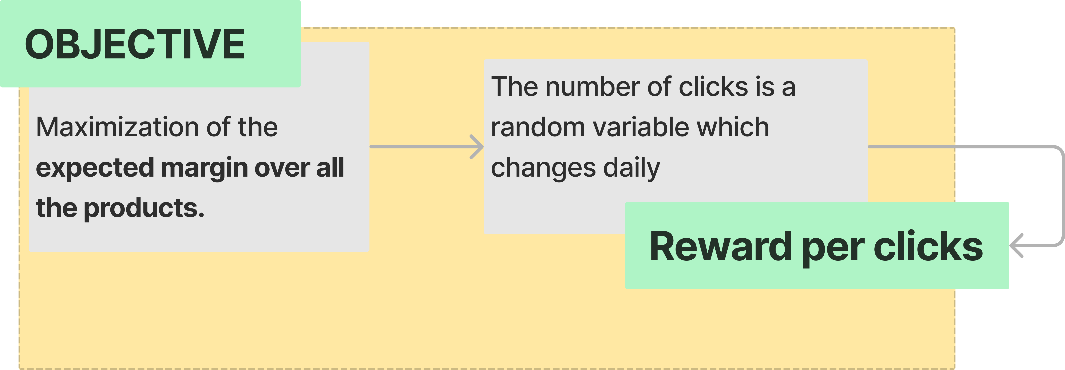
2- Optimization problem & Greedy Algorithm

Slide 17
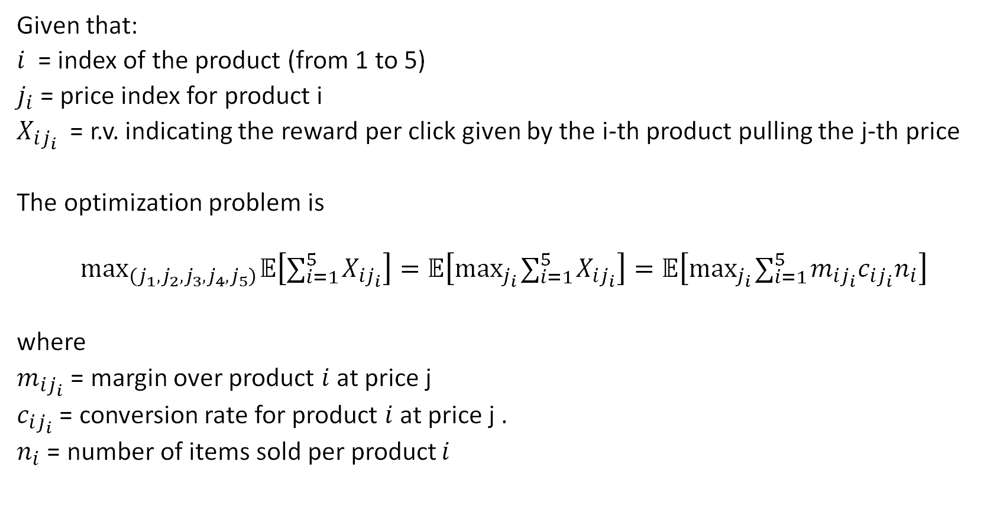
Optimization pricing problem
Given that:
$i$= index of the product (from 1 to 5)
$j_{i}$= price index for product i
$X_{ij_{i}}$ = r.v. indicating the reward per click given by the i-th product pulling the j-th price
The optimization problem is
$$\max_{\left(j_{1},j_{2},j_{3},j_{4},j_{5}\right)} 𝔼\left[∑_{i=1}^{5} X_{ij_{i}}\right]=𝔼\left[\max_{j_{i}} ∑_{i=1}^{5} X_{ij_{i}}\right]=𝔼\left[\max_{j_{i}} ∑_{i=1}^{5} m_{ij_{i}}c_{ij_{i}}n_{i}\right]$$
where
$m_{ij_{i}}$ = margin over product $i$ at price j
$c_{ij_{i}}$ = conversion rate for product $i$ at price j .
$n_{i}$ = number of items sold per product $i$

Slide 18
Optimization pricing problem
The assumptions of the profit maximization problem are:
the rewards are stationary, so the parameters of the probability distributions generating the rewards are stationary (the market does not change in time)
for each product
- a single price is pulled at every time (each day)
- given a price, we can immediately observe the samples
the number of time points (days) is bounded (so not infinite)
according to the specific algorithm applied, prices are updated at each round in order to minimize the cumulative regret

Slide 19
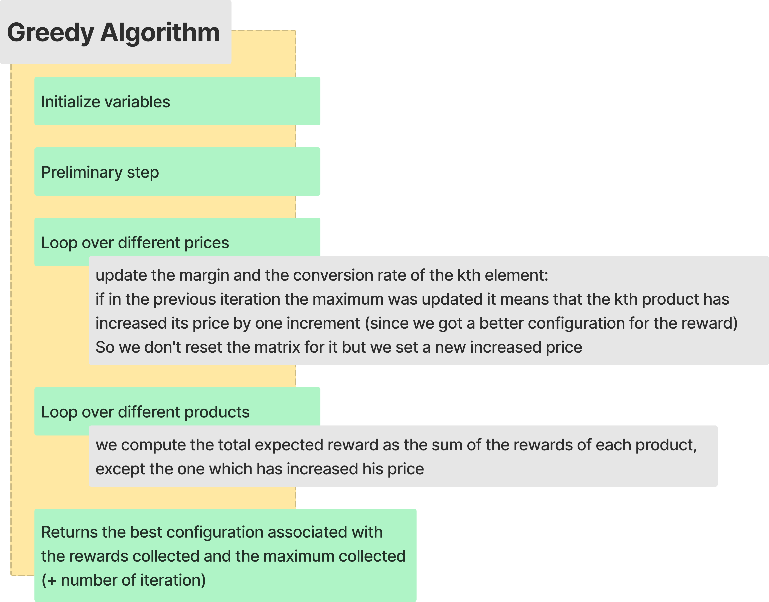

Slide 20
Greedy Algorithm
124,26 | 123,87 | 123,13 | 126,52 | 128,85

Slide 21
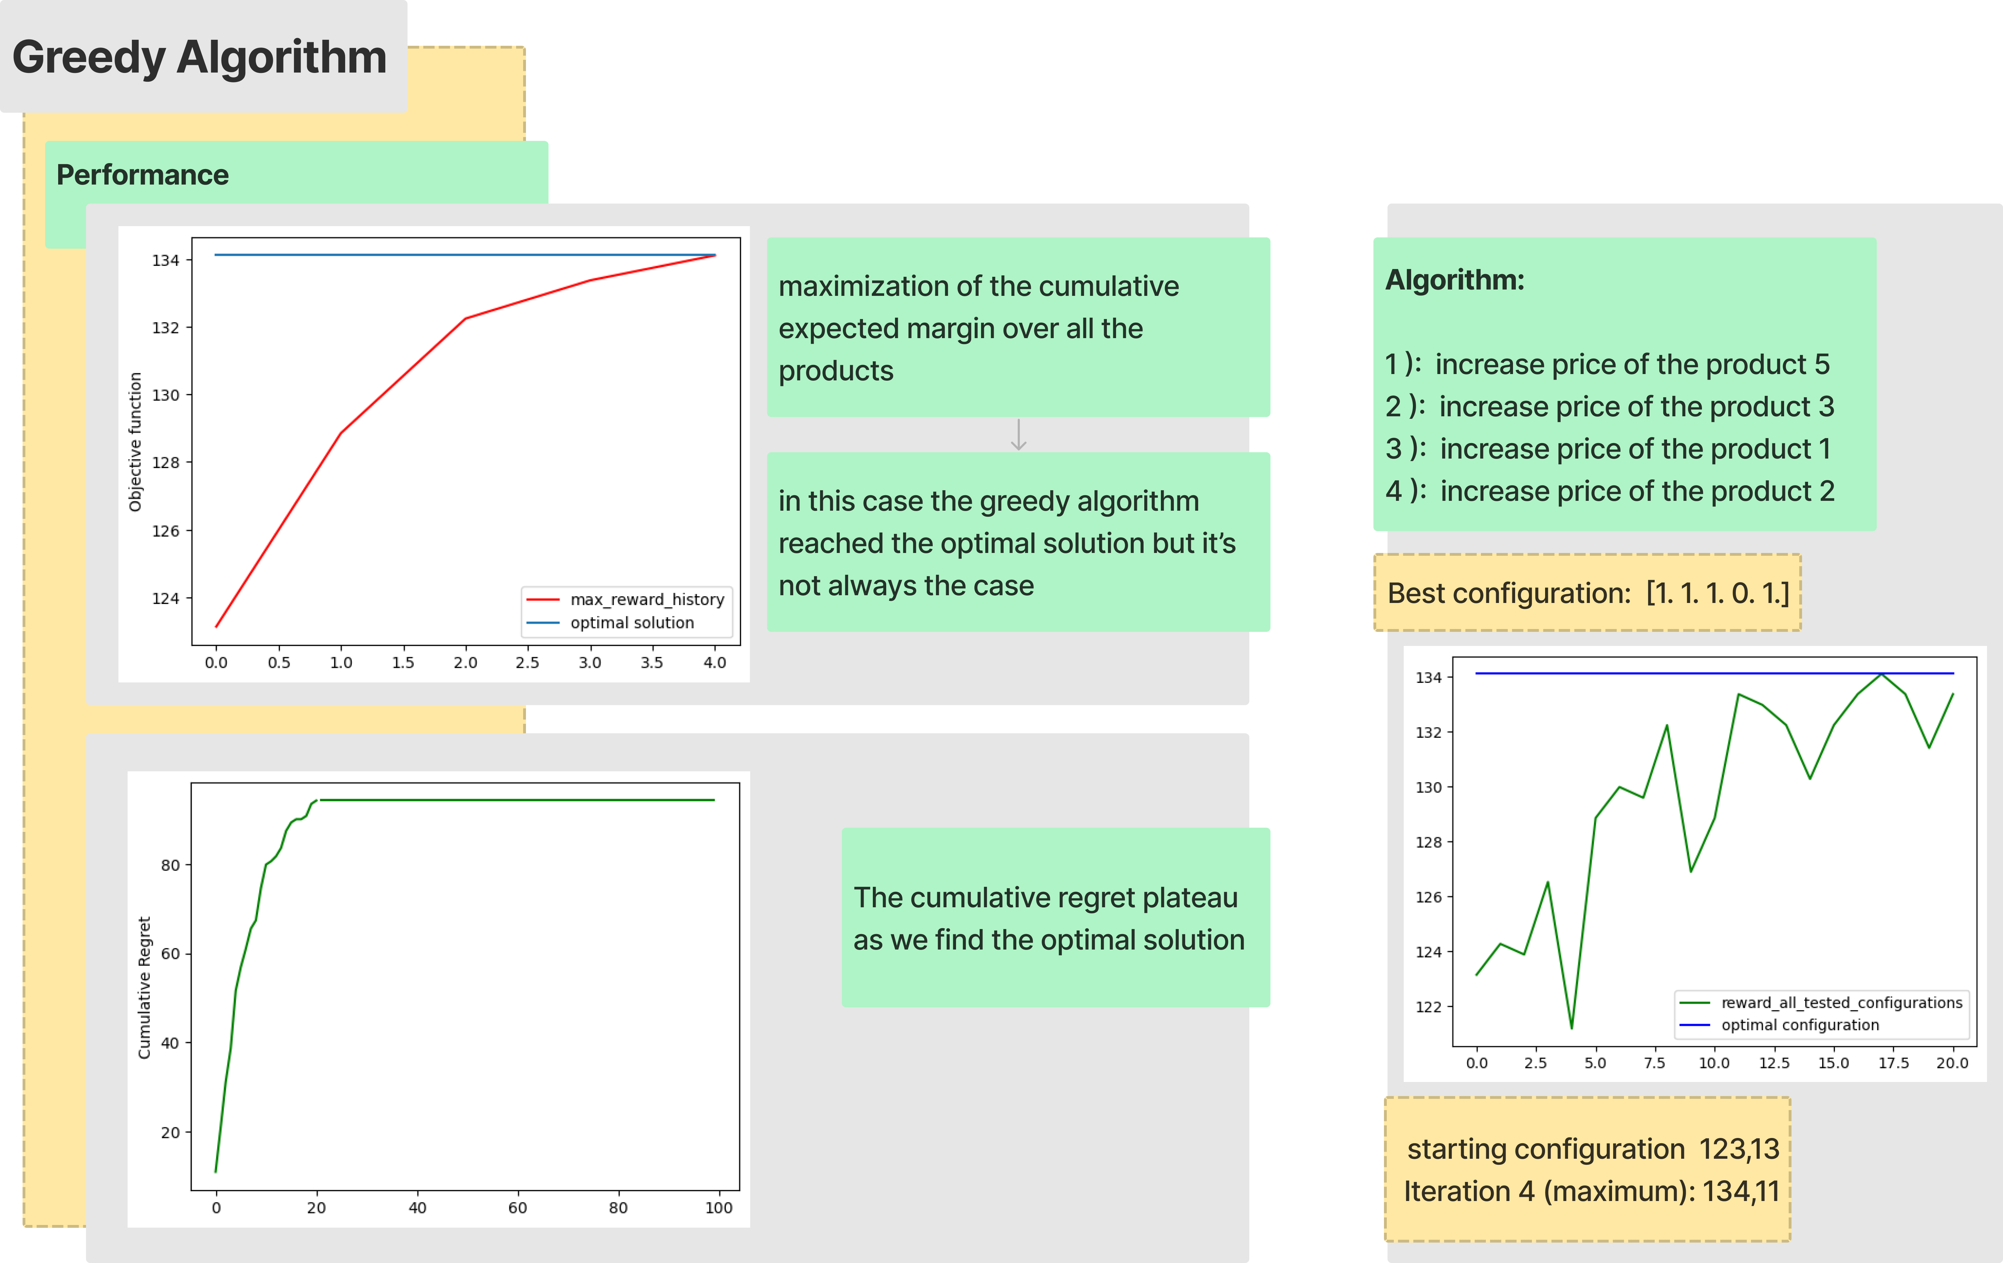

Slide 22
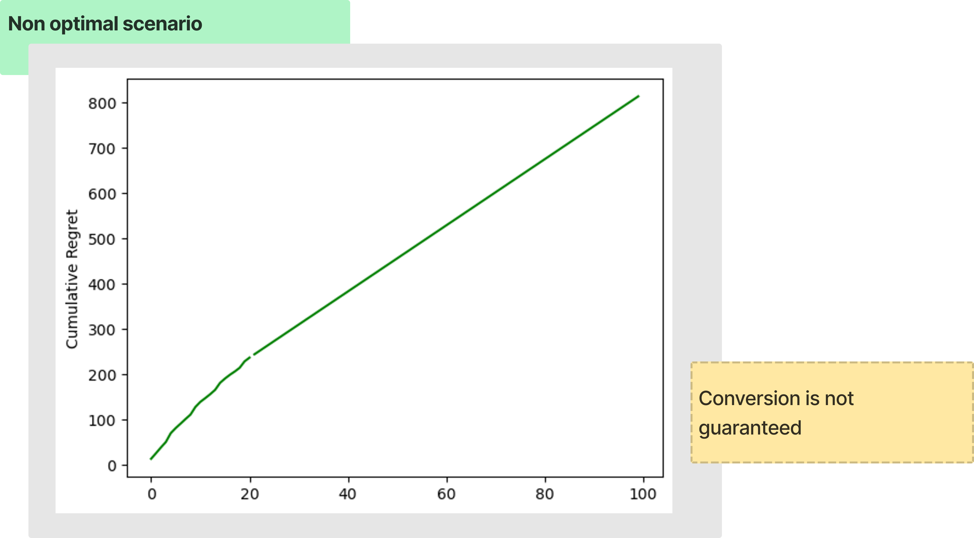

Slide 23
Results Step 2
The greedy algorithm works better in the case the optimal prices are between the first possible arms. This is because the algorithm does not cycle.
Its performances are highly related to the graph weights and reservation prices.

Slide 24
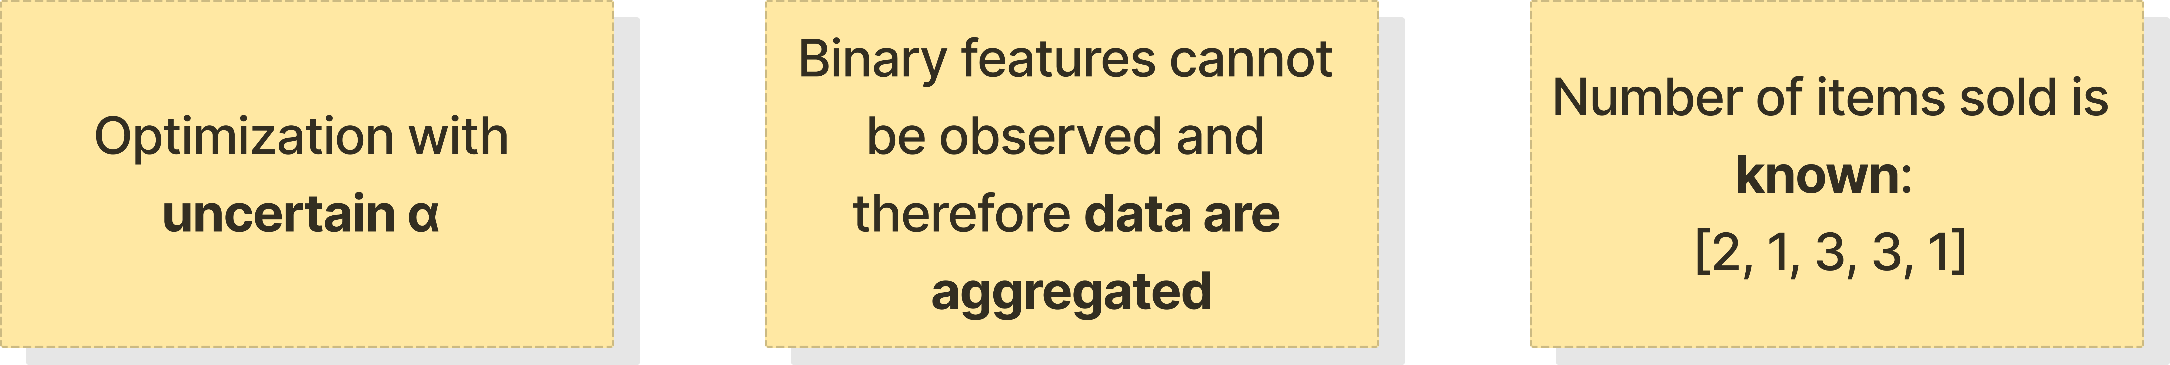
3 – Optimization with uncertain conversion rates

Slide 25
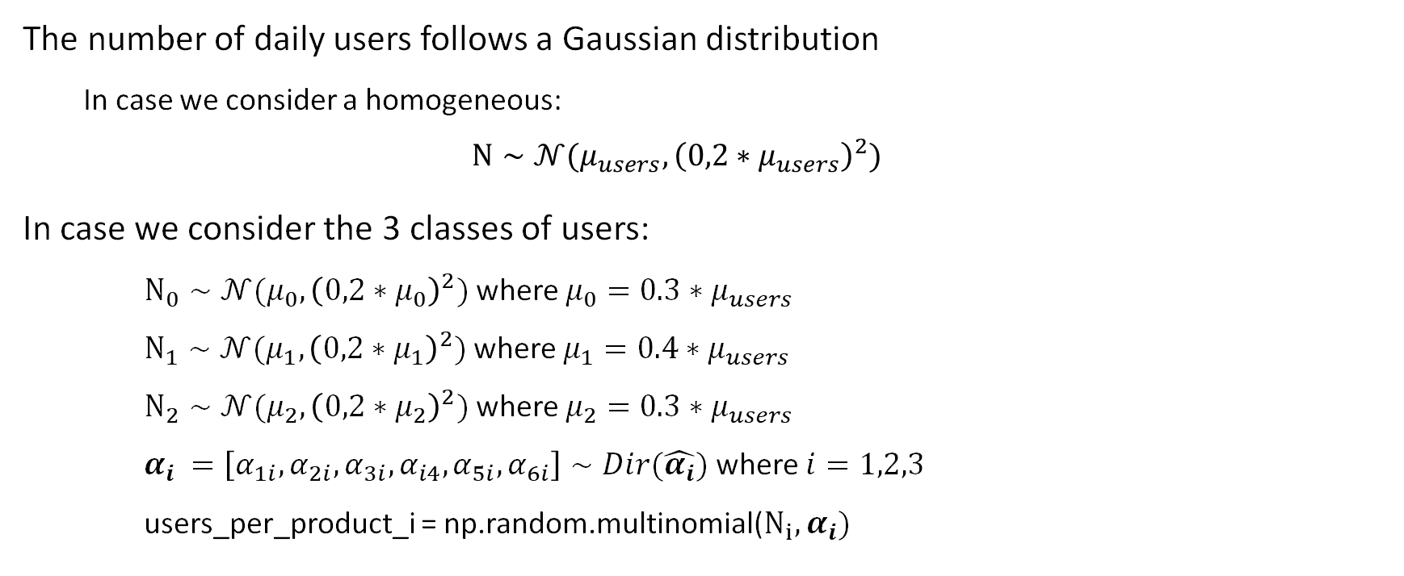
Hypothesis on User Distribution
The number of daily users follows a Gaussian distribution
In case we consider a homogeneous:
$$N∼𝒩(μ_{users},{\left(0,2∗μ_{users}\right)}^{2})$$
In case we consider the 3 classes of users:
$N_{0}∼𝒩(μ_{0},{\left(0,2∗μ_{0}\right)}^{2})$ where ${μ_{0}=0.3∗μ}_{users}$
$N_{1}∼𝒩(μ_{1},{\left(0,2∗μ_{1}\right)}^{2})$ where ${μ_{1}=0.4∗μ}_{users}$
$N_{2}∼𝒩(μ_{2},{\left(0,2∗μ_{2}\right)}^{2})$ where ${μ_{2}=0.3∗μ}_{users}$
$α_{i} =\left[α_{1i},α_{2i},α_{3i},α_{i4},α_{5i},α_{6i}\right]∼Dir(\hat{α_{i}})$ where $i=1,2,3$
users_per_product_i = np.random.multinomial($N_{i},α_{i})$
Notes:
Every day, there is a random number of potential new customers (returning customers are not considered here). In particular, every single customer can land on the webpage in which one of the 5 products is primary or on the webpage of a product sold by a (non-strategic) competitor. Call 𝛼_i the ratio of customers landing on the webpage in which product Pi is primary, and call 𝛼_0 the ratio of customers landing on the webpage of a competitor. In practice, you can only consider the 𝛼 ratios and disregard the total number of users. However, the 𝛼 ratios will be subject to noise. That is, every day, the value of the 𝛼 ratios will be realizations of independent Dirichlet random variables.

Slide 26
Optimization with uncertain conversion rates
STEPS:
Estimation of the conversion rates through an algorithm which pulls cyclically all the arms for each product and simulates the visits in the website.
Computation of the optimal "clairvoyant" solution per round and of the best configuration:
Best_arm_per_product = argmax(margin_matrix*conv_rates)
Design of the optimization algorithms: TS and UCB
Every day we compute the reward for each product in the Learning Environment:
reward[i] = E.daily_rewards_per_product[i] / clicks_current_day[i]

Slide 27
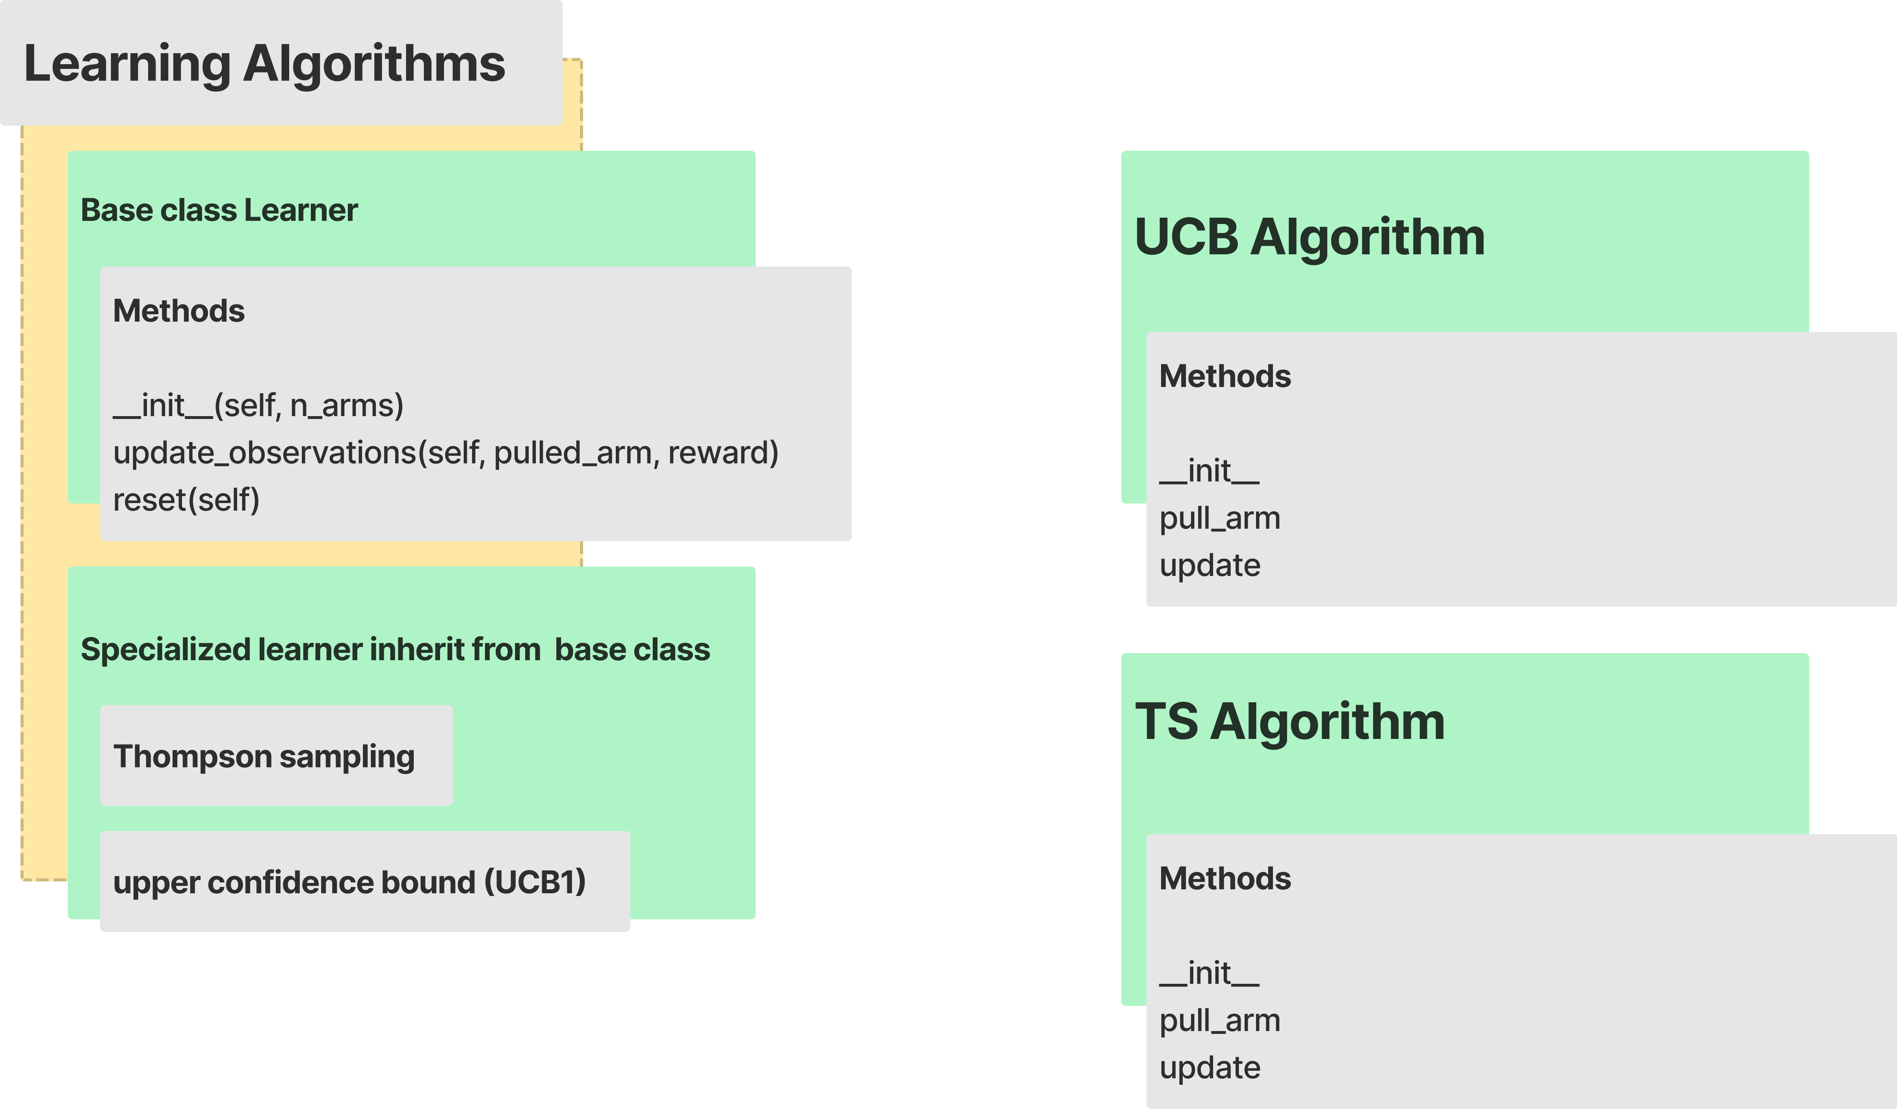

Slide 28
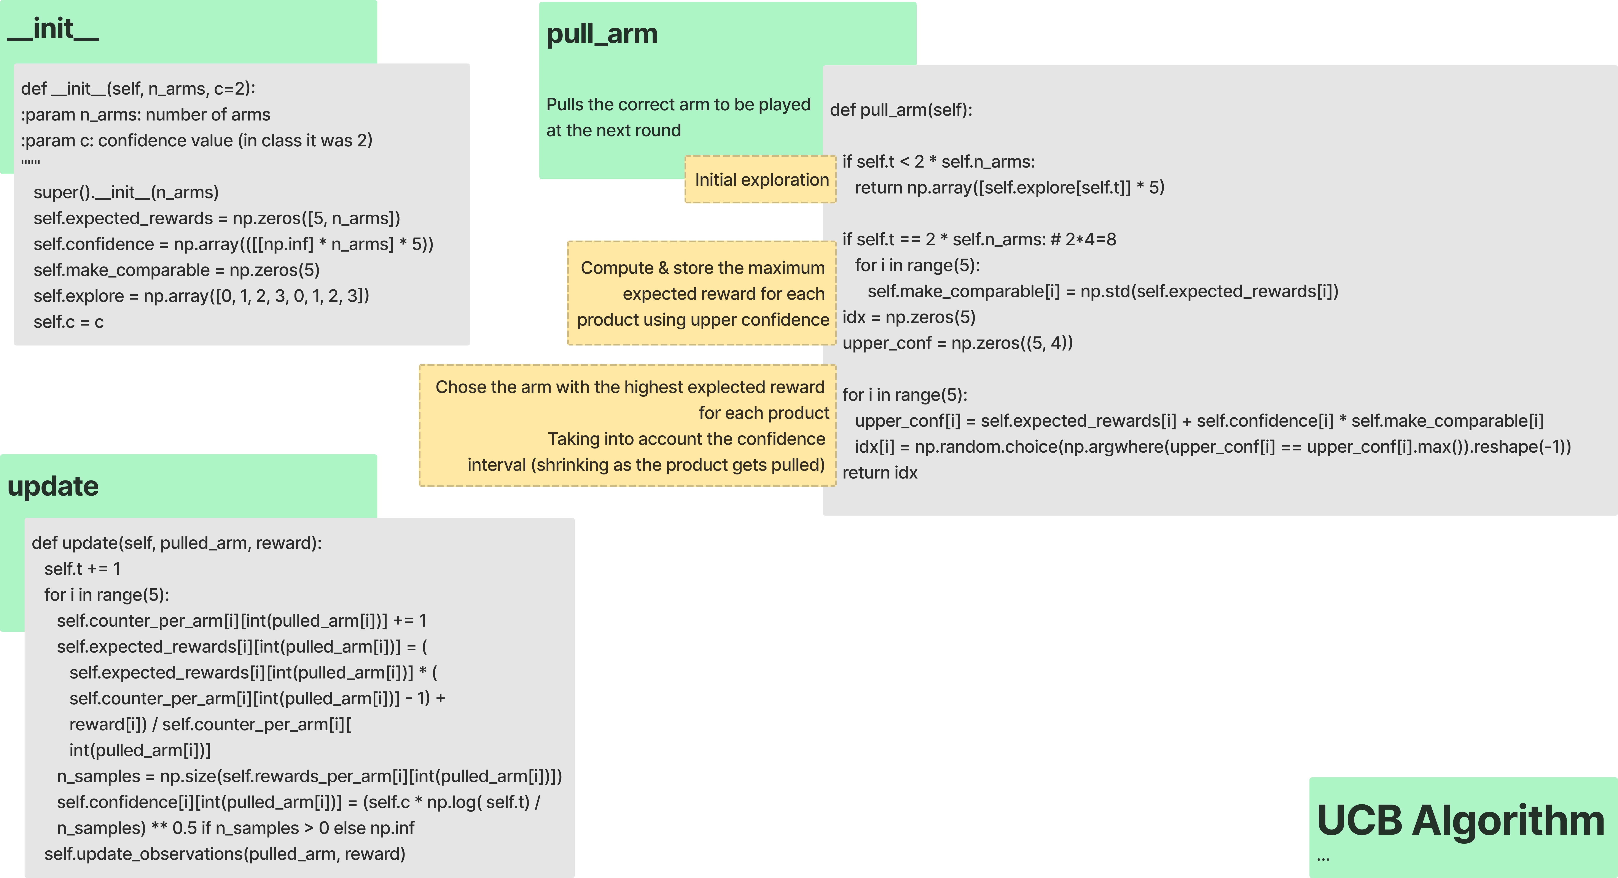

Slide 29
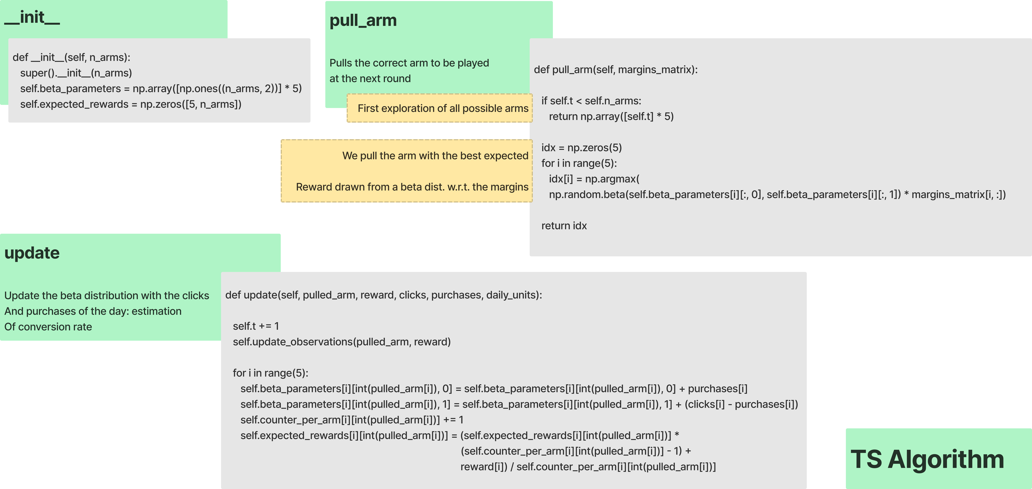

Slide 30
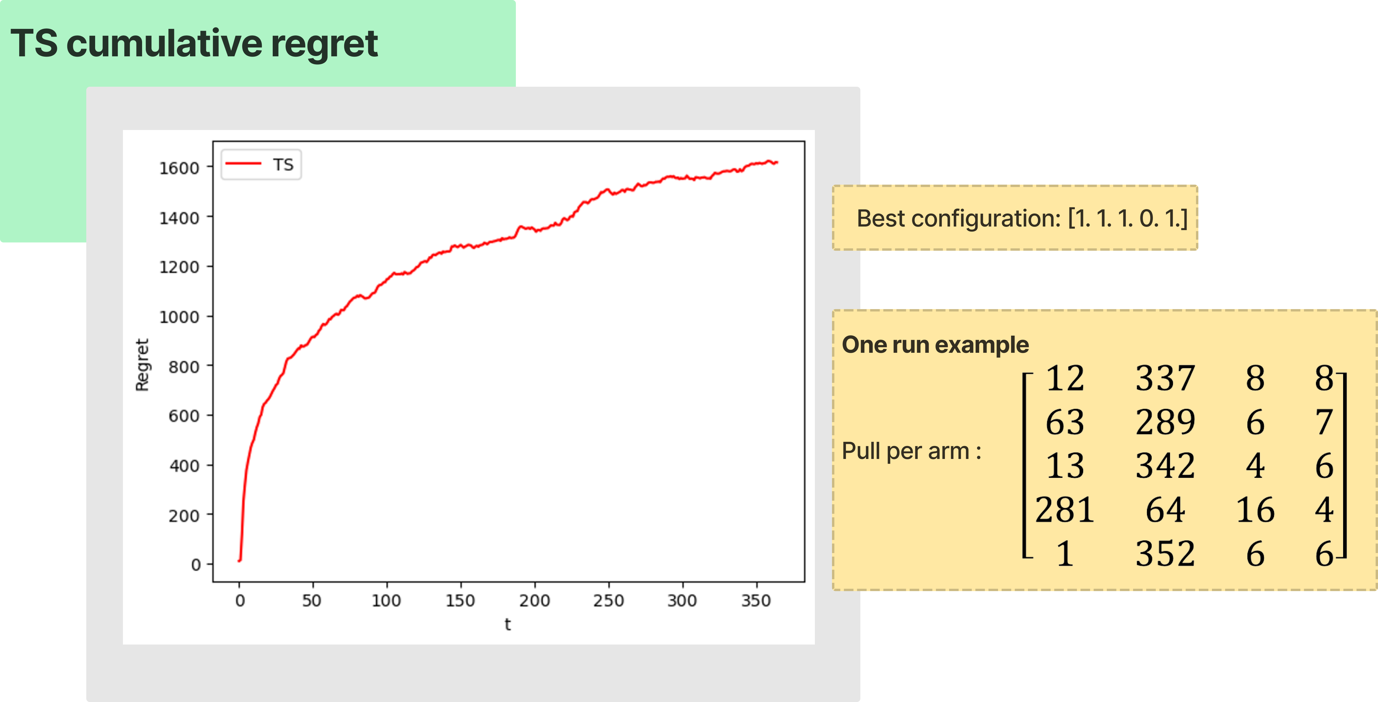

Slide 31


Slide 32
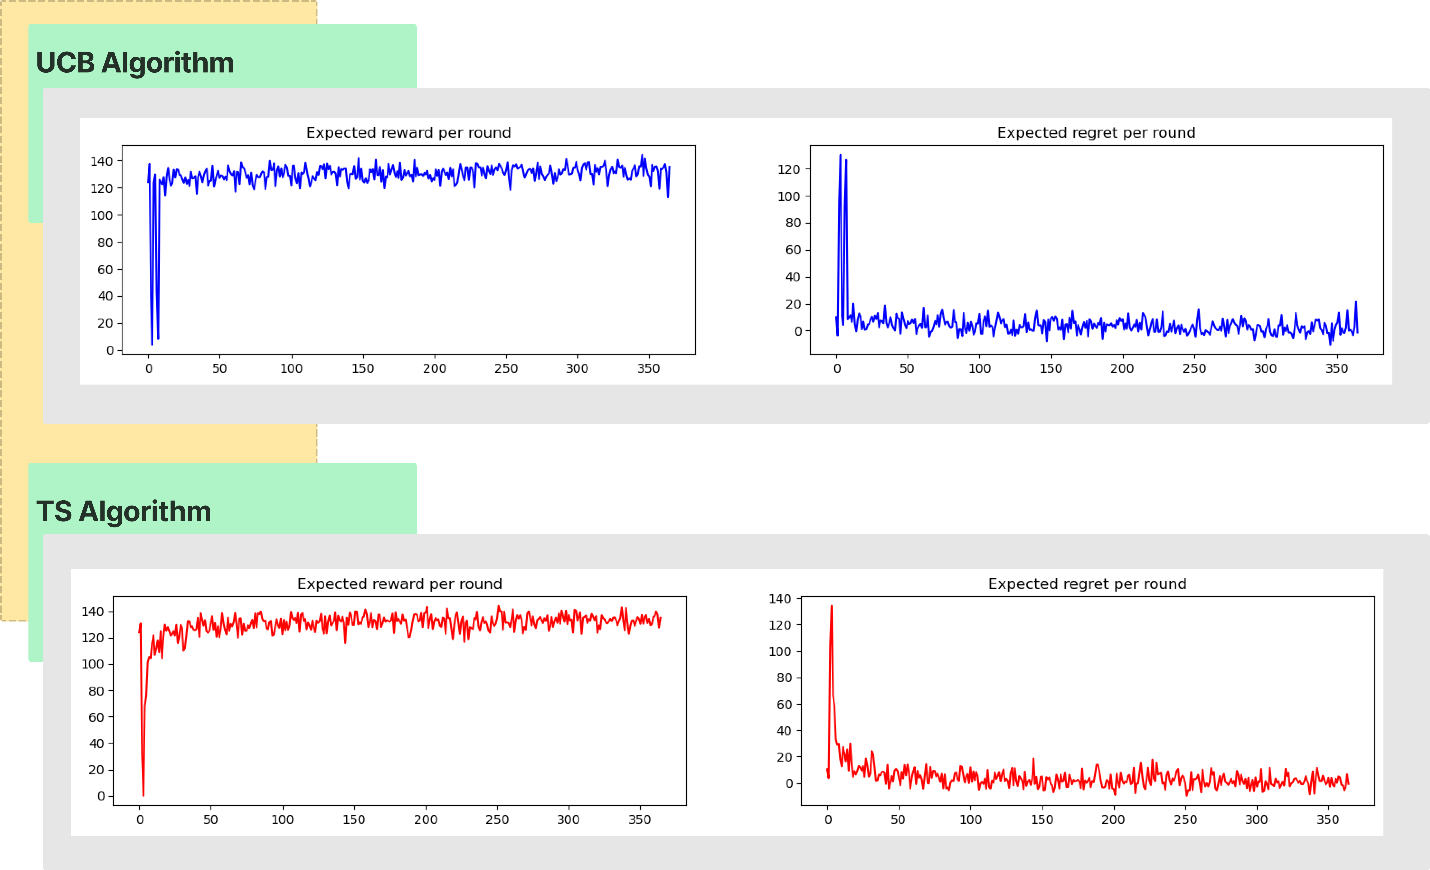

Slide 33
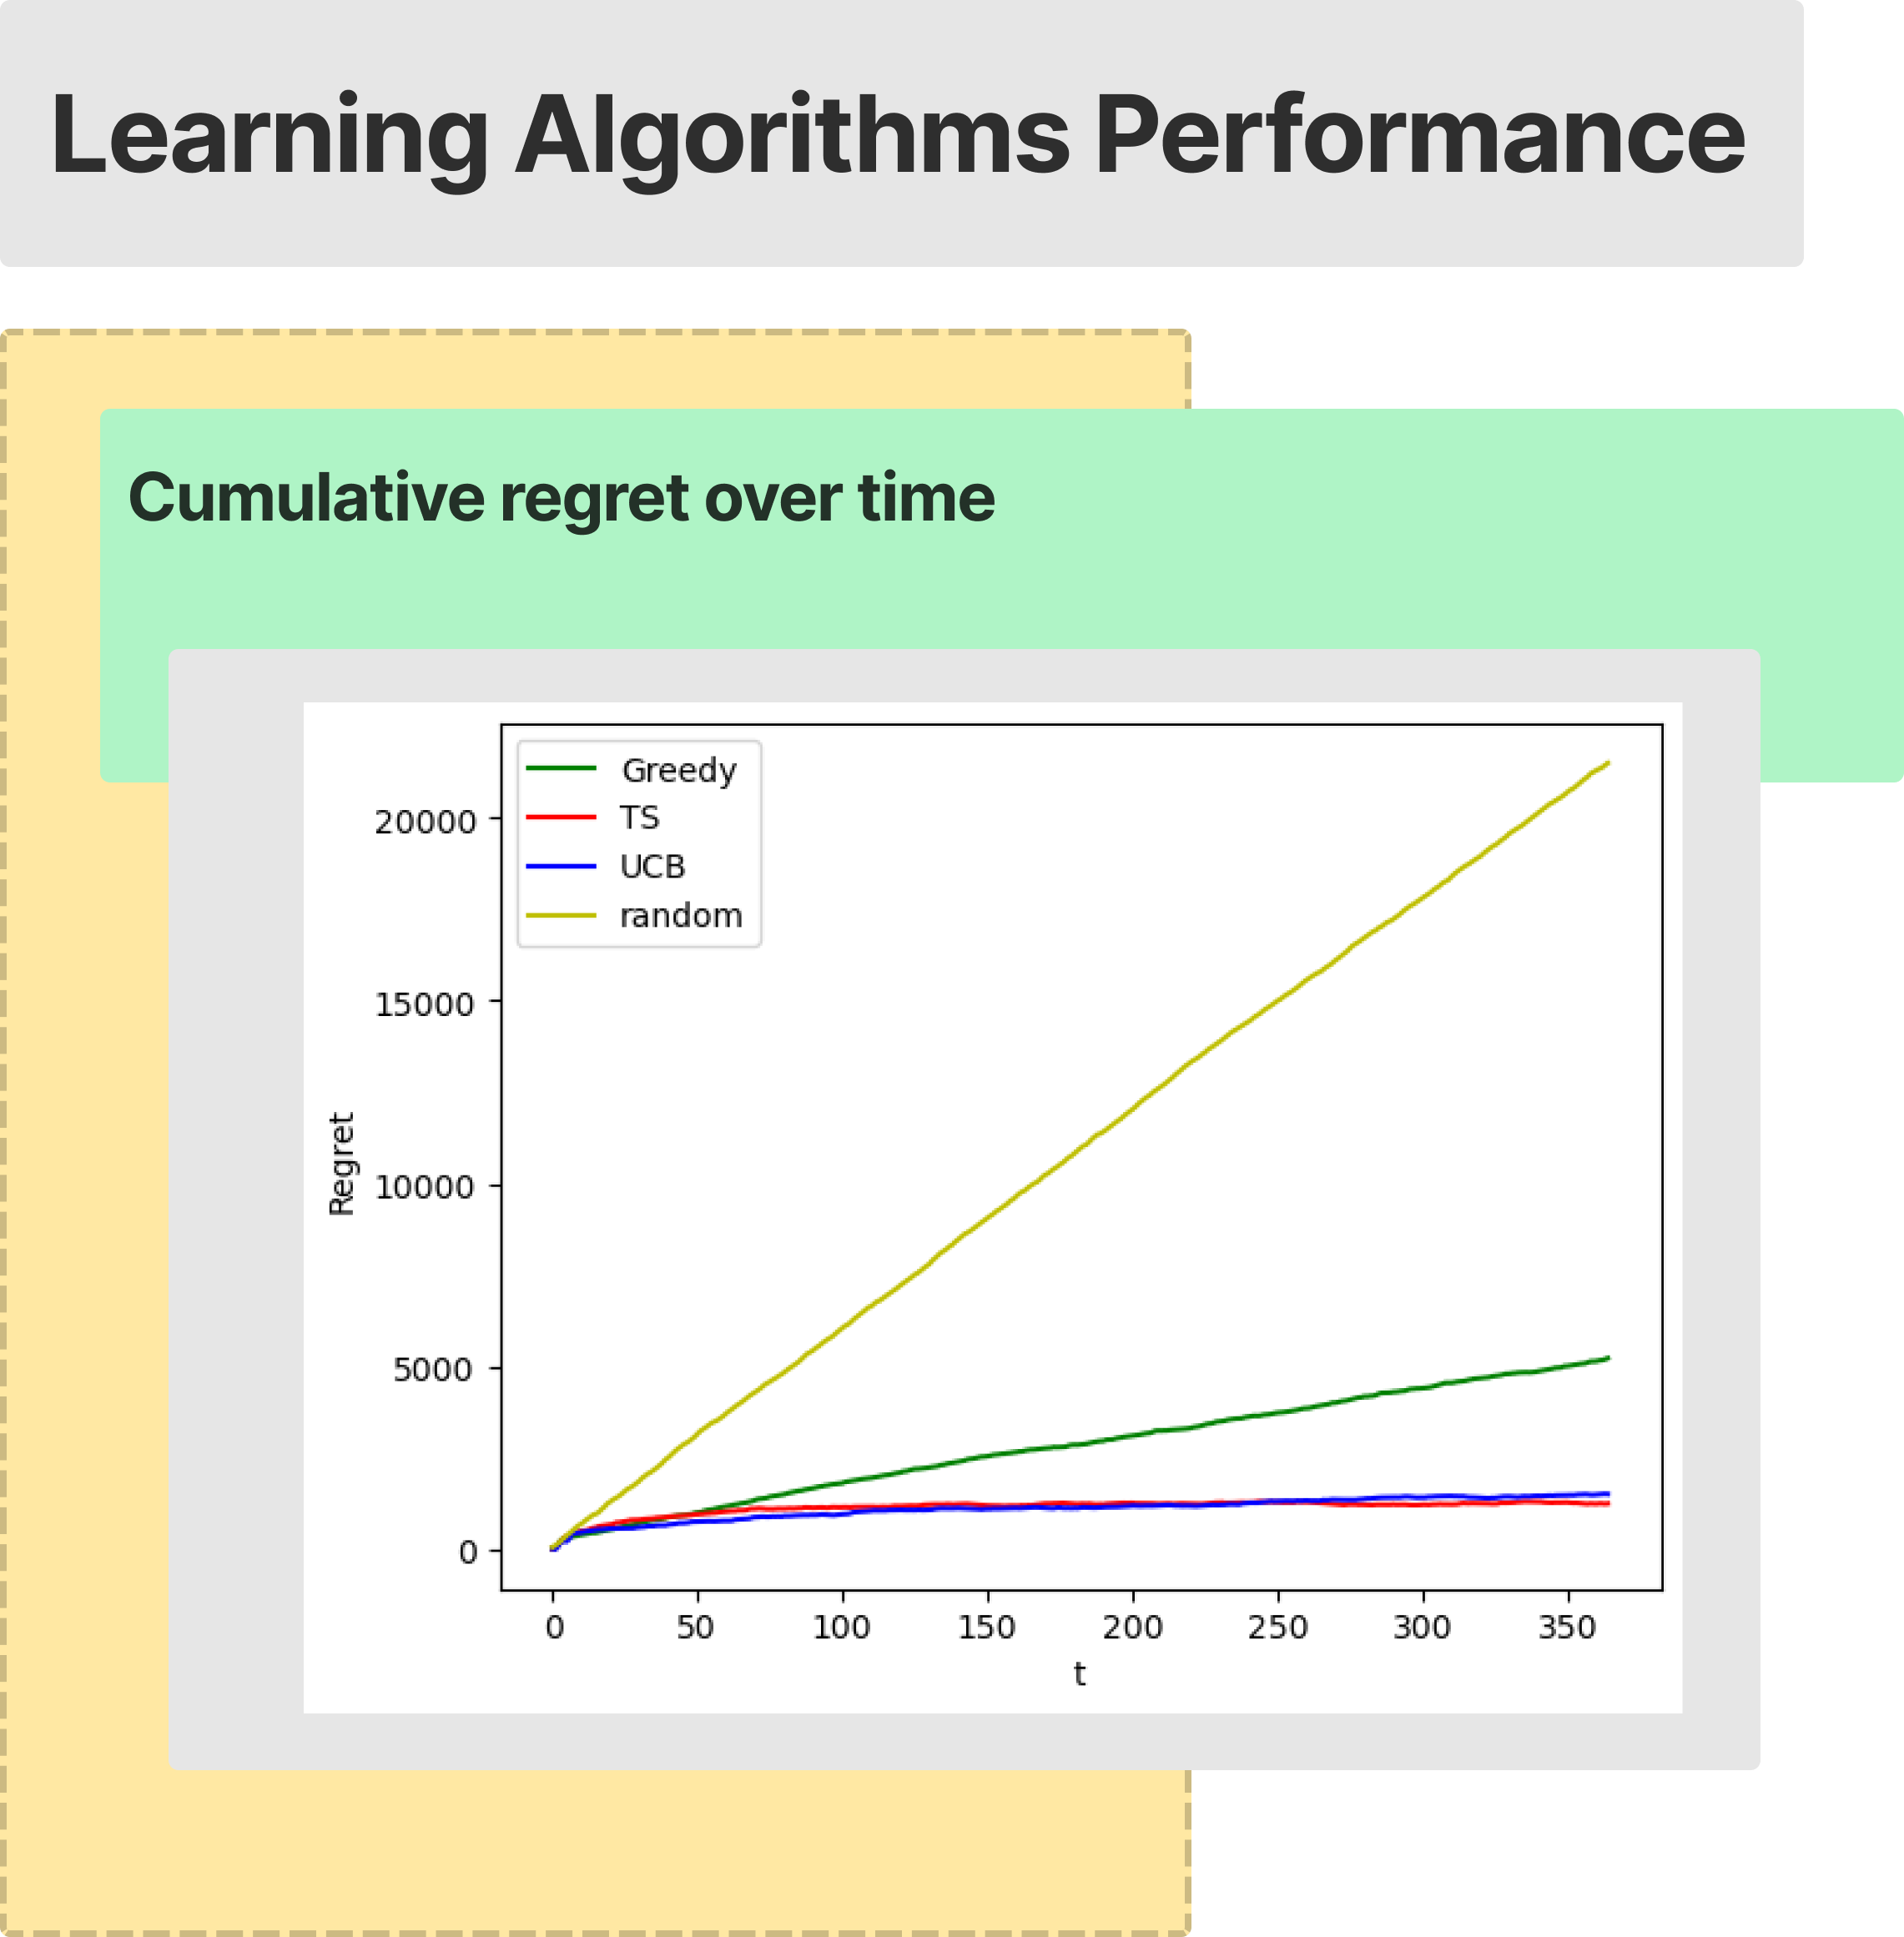
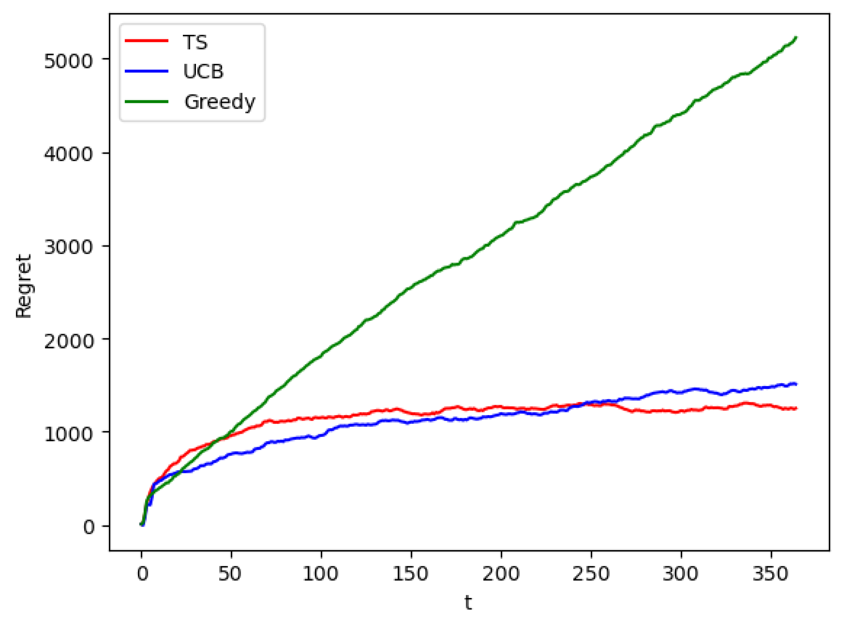

Slide 34
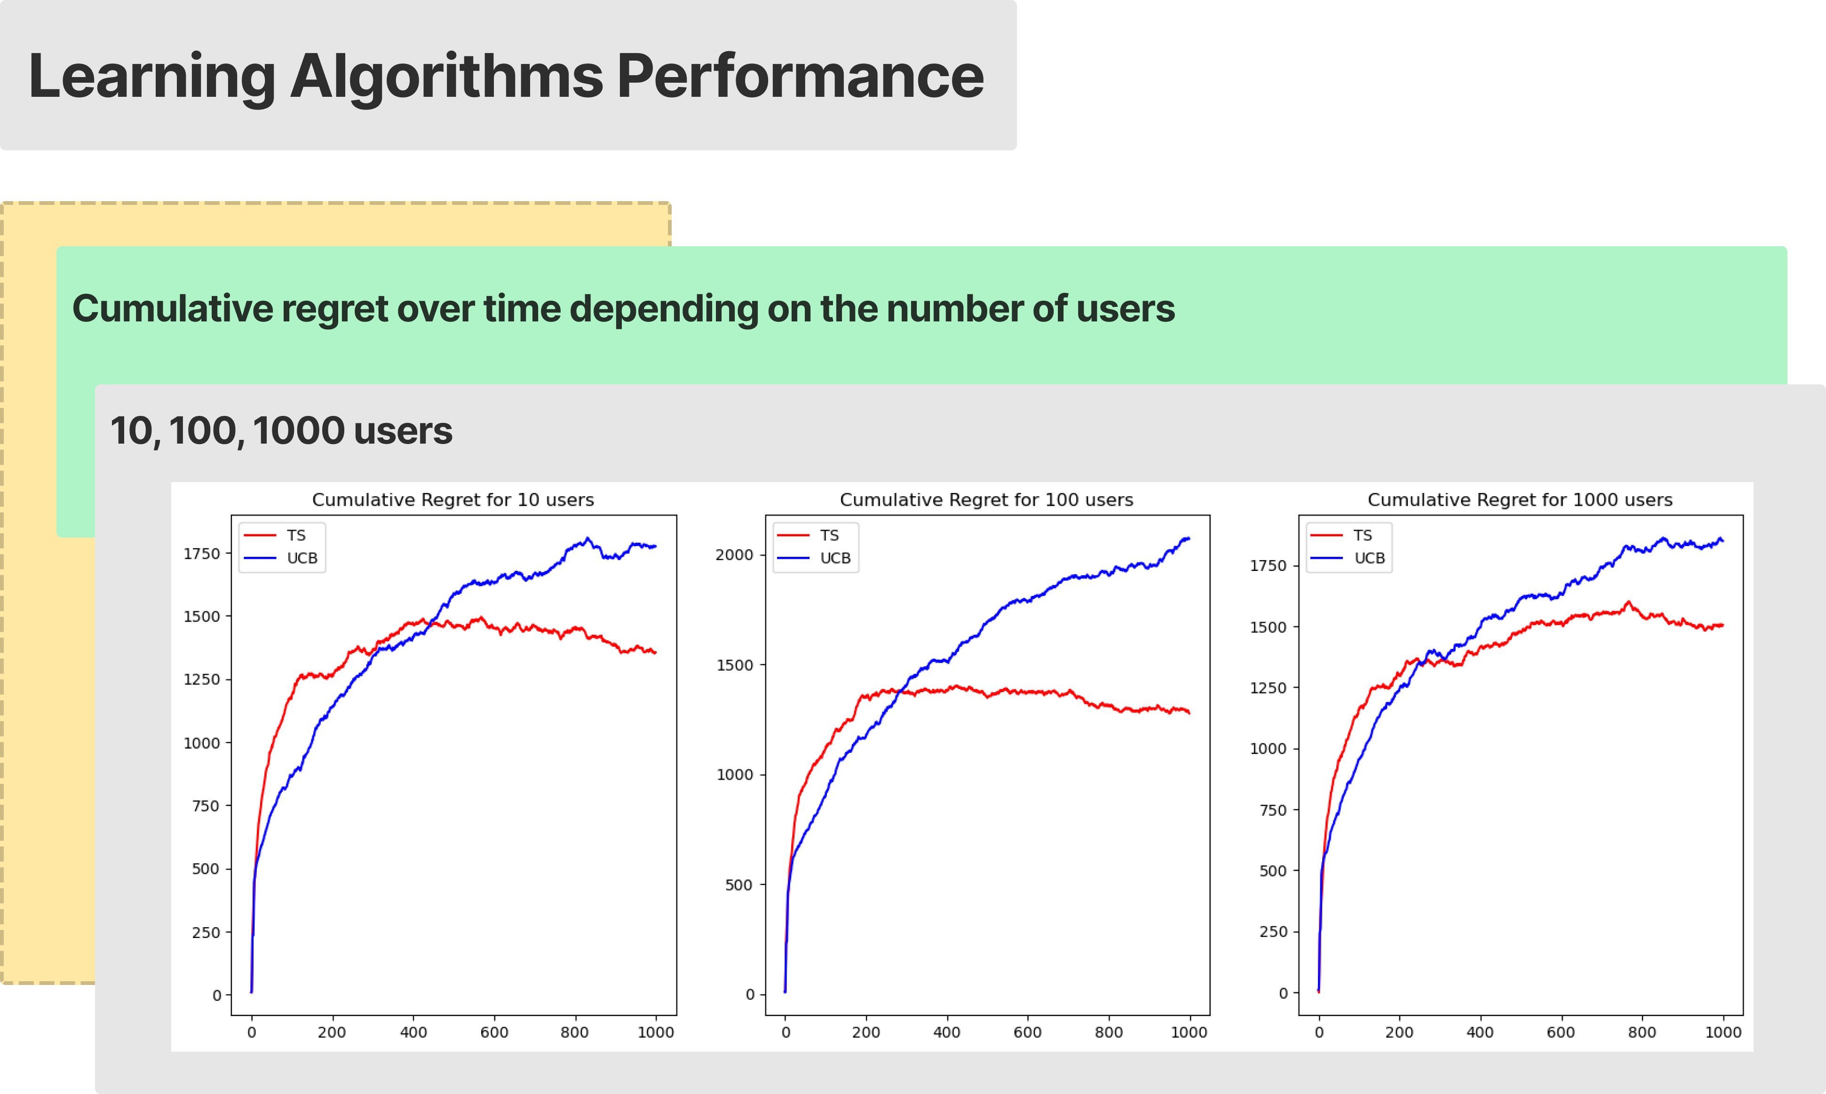

Slide 35
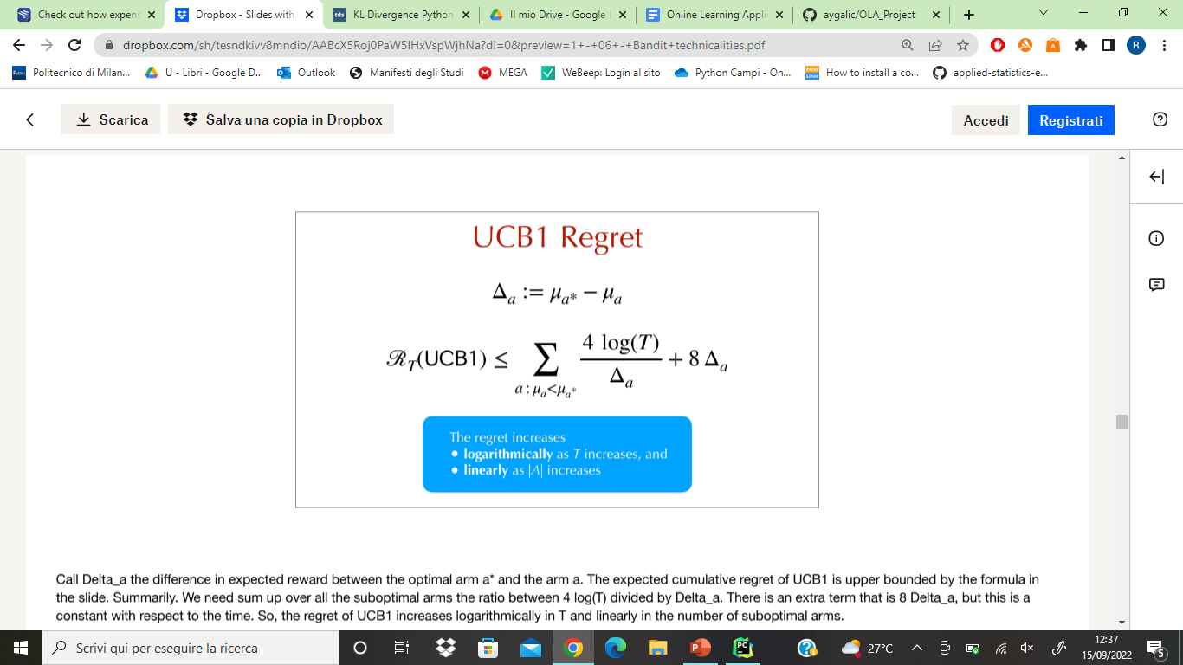
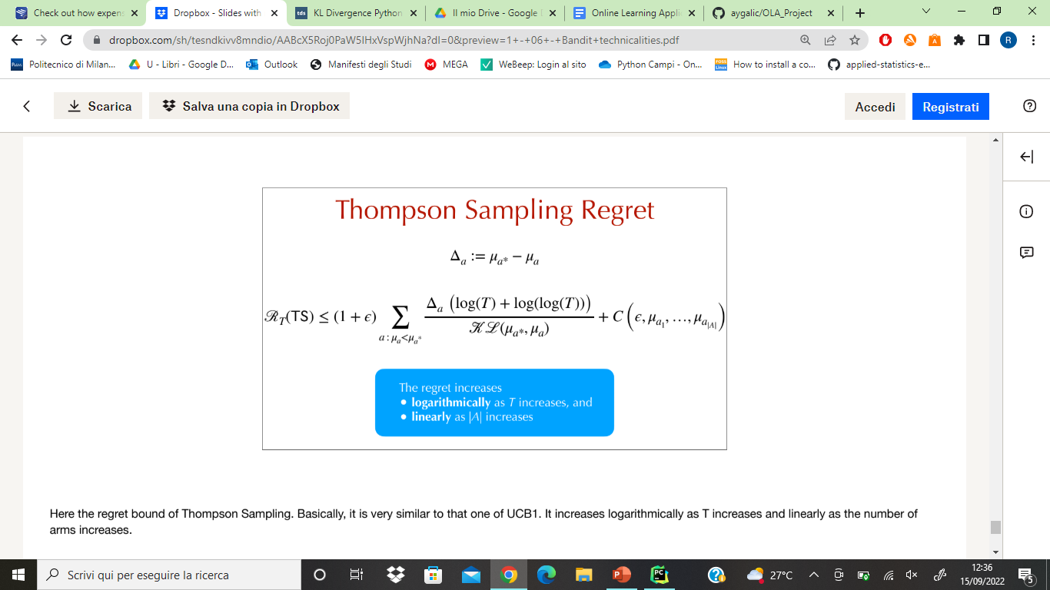
Theoretical bounds
Empirical regret over 365 rounds: 1758
Empirical regret over 365 rounds: 1615
Taking into account that our rewards are computed per click (margin * conv_rate * numb_units) and not drawn from a Bernoulli.

Slide 36
Results of step 3
Results considering a period of 365 days over 20 runs:
Expected total collected rewards with the best configuration: 48983
TS Total collected reward: 47368 with 554 of standard deviation between the experiments
UCB Total collected reward: 47225 with 401 of standard deviation between the experiments
TS cumulative expected regret: 1615
UCB cumulative expected regret: 1758
Expected reward per round with the best configuration: 134.20
TS average expected reward per round: 129.77
UCB average expected reward per round: 129.38
TS average expected regret per round: 4.42
UCB average expected regret per round: 4.81

Slide 37
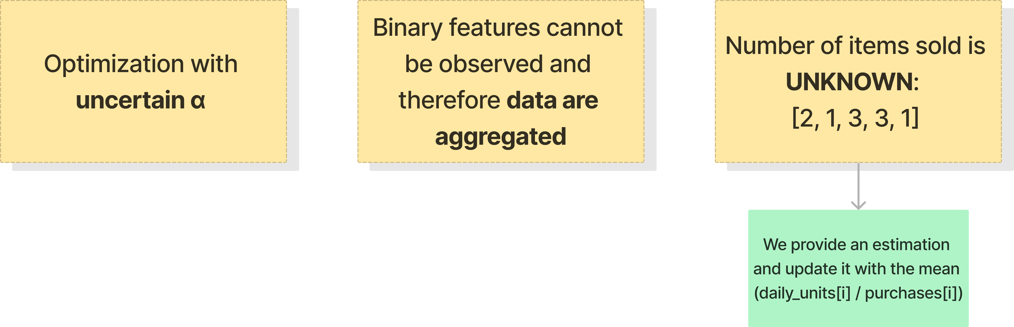
4 – Optimization with uncertain conversion rates, alpha ratios and number of items sold per product

Slide 38
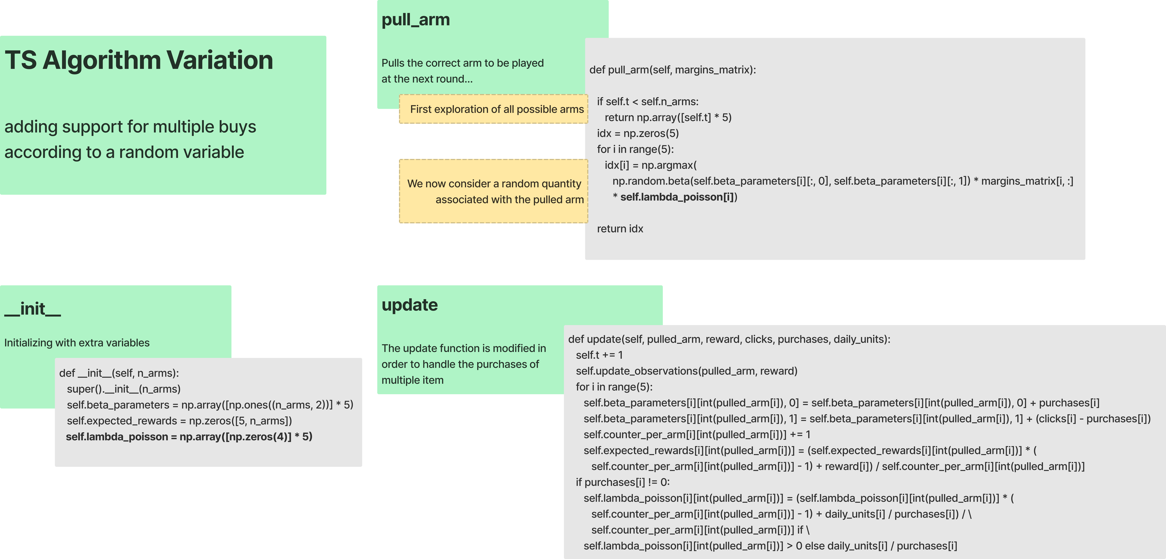

Slide 39
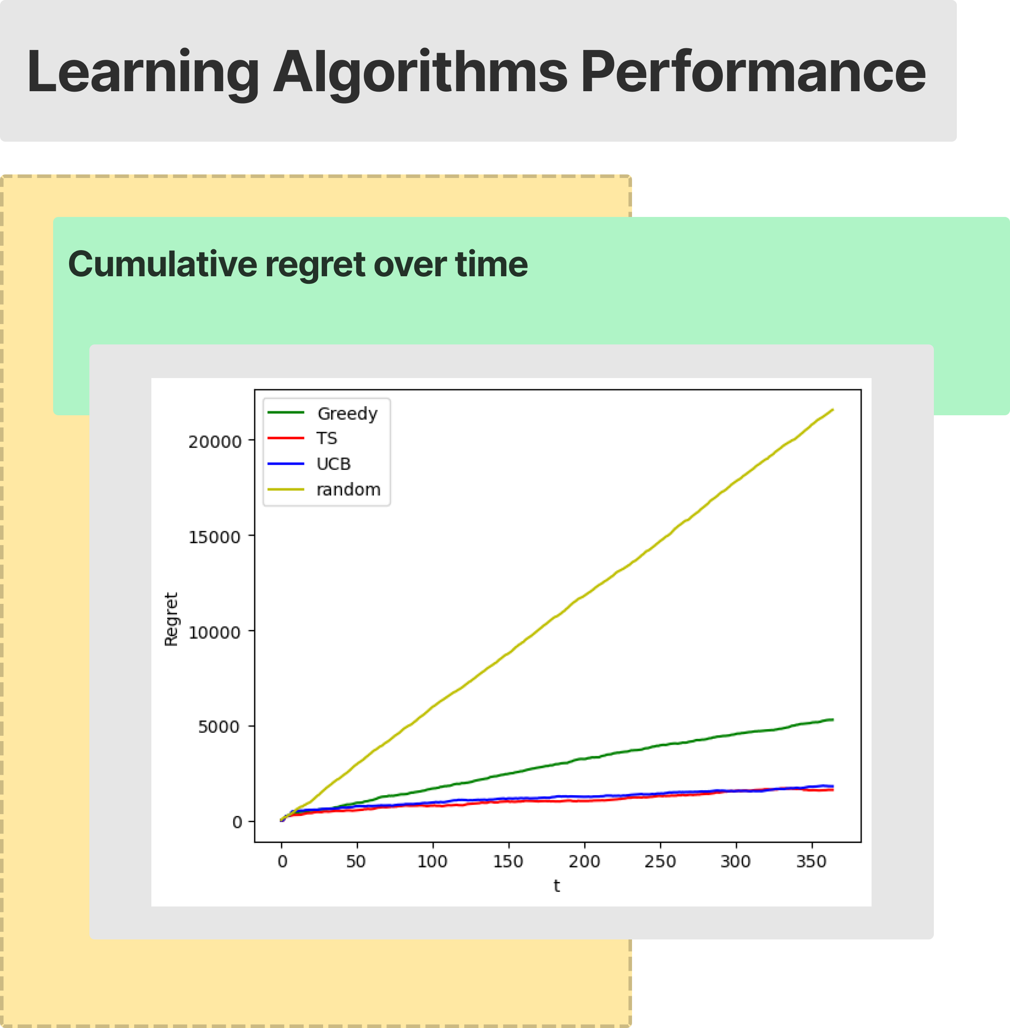
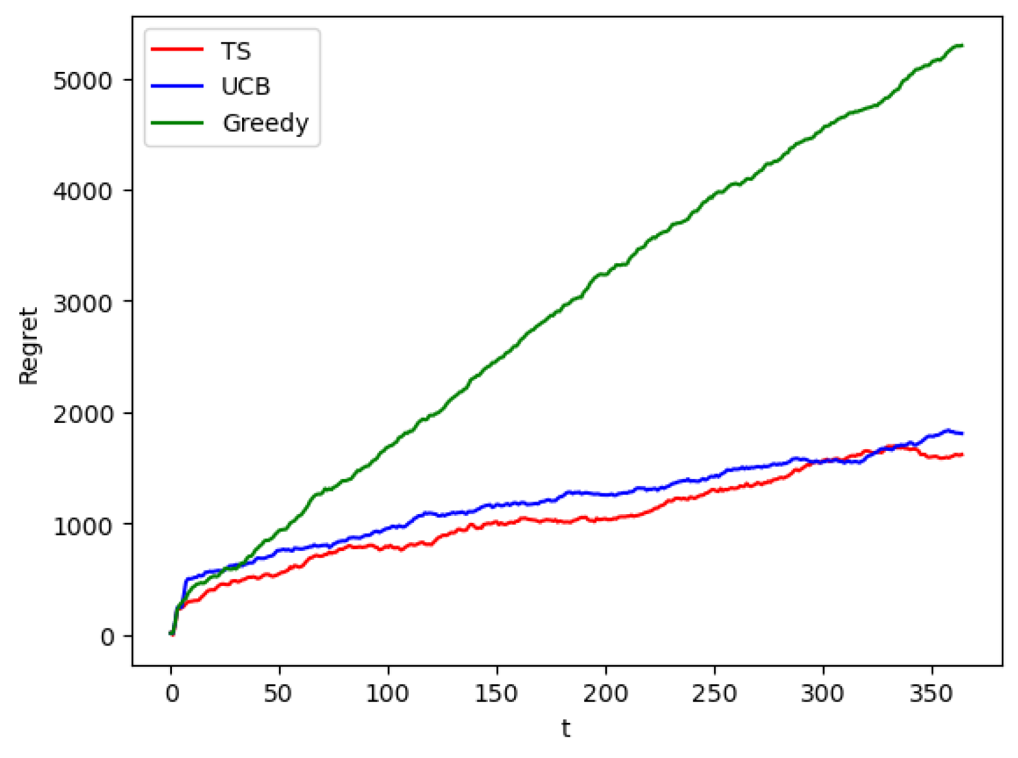

Slide 40
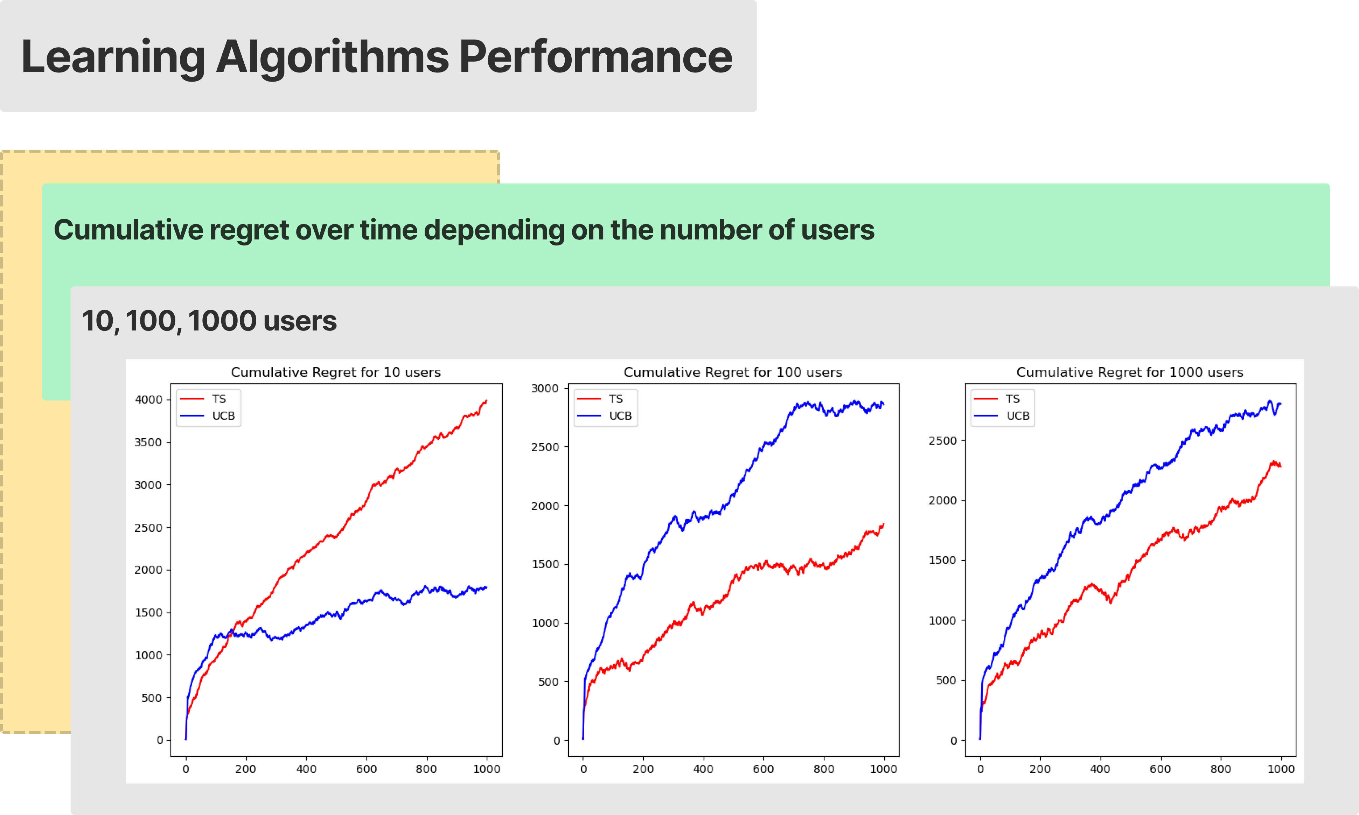

Slide 41
Results step 4
Results considering a period of 365 days over 20 runs:
Expected total collected rewards with the best configuration: 48804
TS Total collected reward: 47189 with 904 of standard deviation between the experiments
UCB Total collected reward: 47000 with 687 of standard deviation between the experiments
TS cumulative expected regret: 1615
UCB cumulative expected regret: 1804
Expected reward per round with the best configuration: 133.71
TS average expected reward per round: 129.28
UCB average expected reward per round: 128.76
TS average expected regret per round: 4.43
UCB average expected regret per round: 4.94

Slide 42
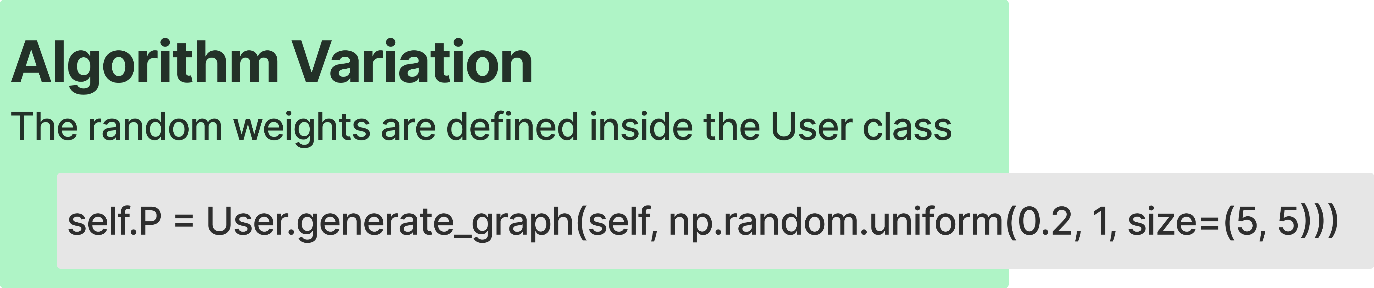
5 – Optimization with uncertain graph weights

Slide 43

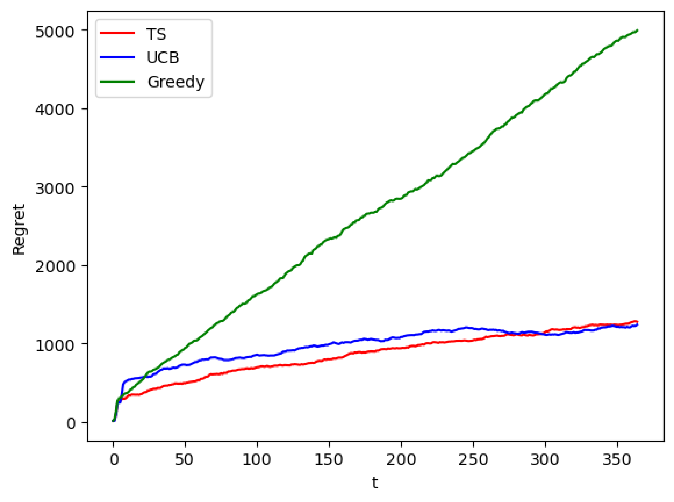

Slide 44
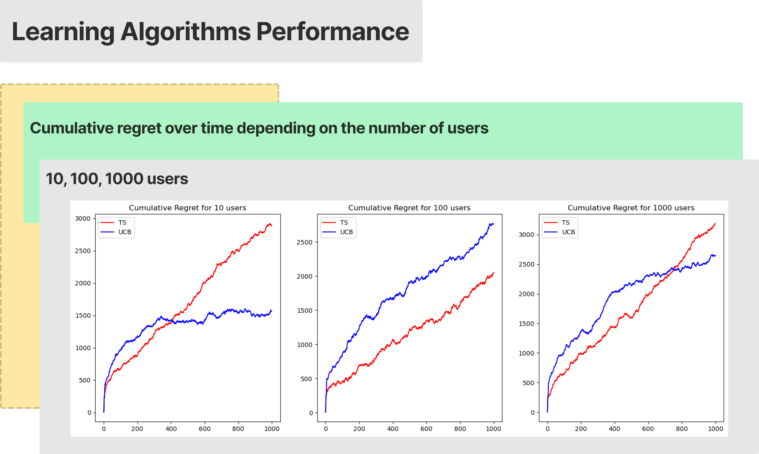

Slide 45
Results step 5
Results considering a period of 365 days over 20 runs:
Expected total collected rewards with the best configuration: 48873
TS Total collected reward: 47602 with 863 of standard deviation between the experiments
UCB Total collected reward: 47641 with 547 of standard deviation between the experiments
TS cumulative expected regret: 1271
UCB cumulative expected regret: 1232
Expected reward per round with the best configuration: 133.90
TS average expected reward per round: 130.41
UCB average expected reward per round: 130.52
TS average expected regret per round: 3.48
UCB average expected regret per round: 3.38

Slide 46
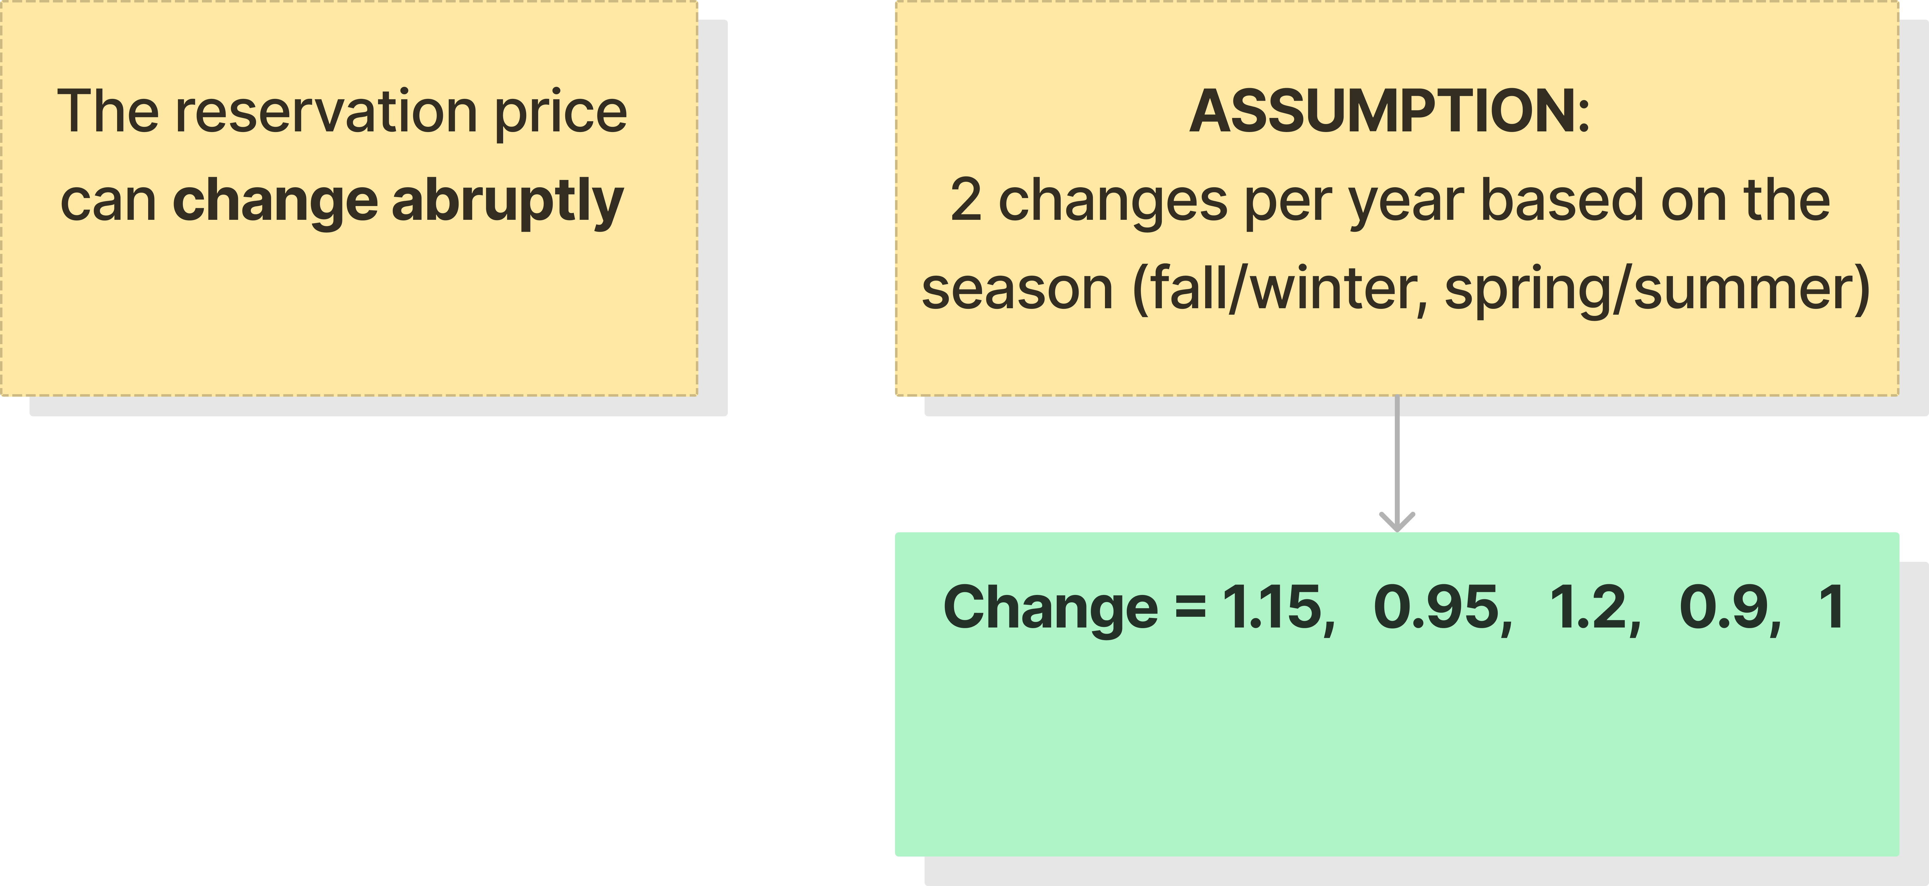
Step 6 - Non stationary demand curves
Notes:
The objective of the step 6 was to learn the demand curves in a non-stationary environment. In particular, we were asked to face this non-stationarity with two kinds of UCB-like approches: first, a sliding-window UCB and second a UCB with a change detection algorithm.
We have seen that these algorithms perform very differently depending on the magnitude and frequency of change. In these slides, we will present the results obtained when we assume only 2 annual changes based on seasonality.

Slide 47
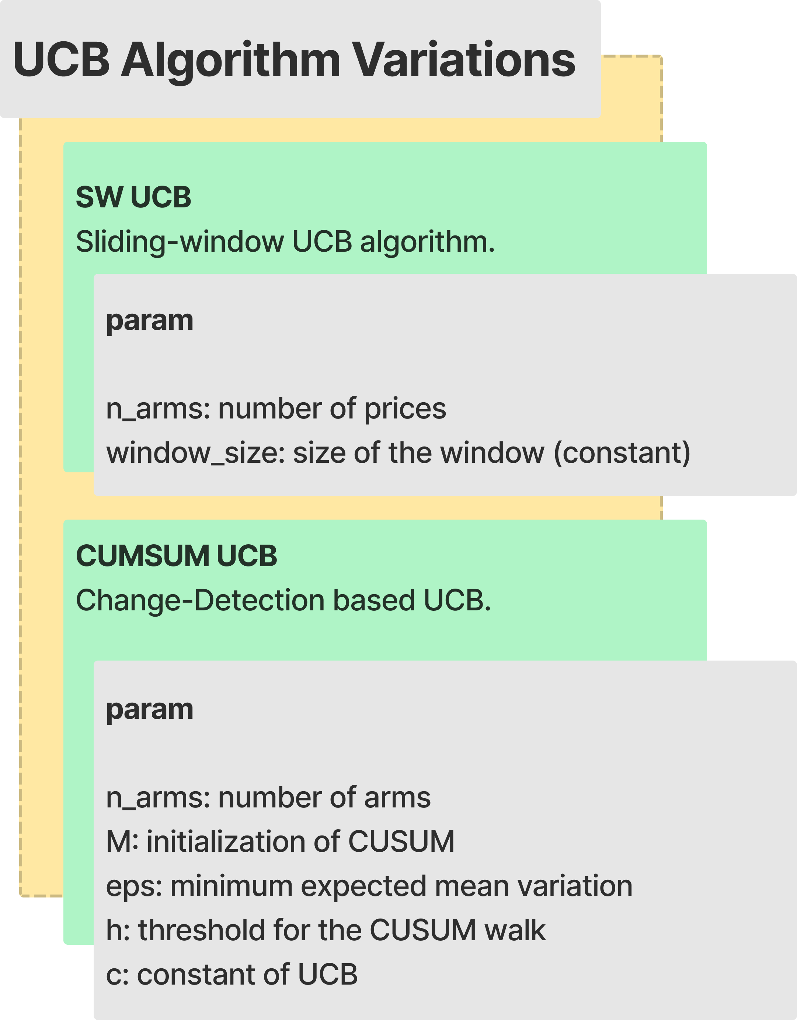
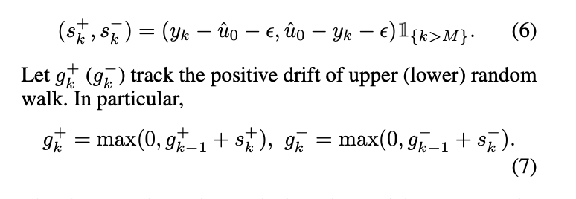
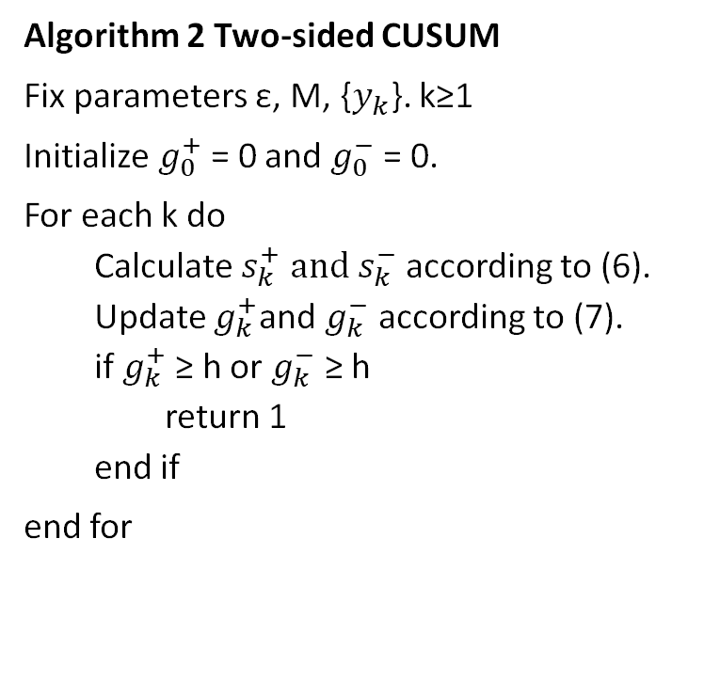
Algorithm 2 Two-sided CUSUM
Fix parameters ε, M, {$y_{k}$}. k≥1
Initialize $g_{0}^{+}$= 0 and $g_{0}^{−}$= 0.
For each k do
Calculate $s_{k}^{+} and s_{k}^{−}$according to (6).
Update $g_{k}^{+}$and $g_{k}^{−}$ according to (7).
if $g_{k}^{+}$≥ h or $g_{k}^{−}$ ≥ h
return 1
end if
end for
*Fang Liu and Joohyun Lee and Ness Shroff
Notes:
The algorithm we used for change-detection is called CUSUM and we can see it here on the right. The algorithm aims to understand if the conversion rates n_buy/n_cliks are changing. The algorithm collects M data than compute hat u_0 which would be the mean conversion rate. Then, at each iteration we make the difference between y_k and hat u_0 and we take out from this distance from the mean epsilon, which states for the uncertainty. At each step, we sum all these differences up they overcome a set threashold h. We do this procedure both for the left and right tail.

Slide 48
Step 6 - Non stationary demand curves
winter
Notes:
The prices we have used so far are assumed for the winter period. In early April, temperatures rise and customers start buying more T-shirts and shorts. We assume that this change is sudden and of 15% in the first case and 20% for shorts. In contrast, the reservation price for shirts and long trousers get lower: 95% and 90% of baseline

Slide 49
Step 6 - Non stationary demand curves
winter
Spring - summer
Notes:
The prices we have used so far are assumed for the winter period. In early April, temperatures rise and customers start buying more T-shirts and shorts. We assume that this change is sudden and of 15% for t-shirts and 2 0% for shorts. In contrast, the reservation price for shirts and long trousers get lower:95% and 90% of baseline
In October we see the opposite behaviour. The reservation prices are taken as the one at the beginning of the year.

Slide 50
Step 6 - Non stationary demand curves
winter
Spring - summer
fall
Notes:
In October we see the opposite behaviour. The reservation prices are taken as the winter price at the beginning of the year.

Slide 51
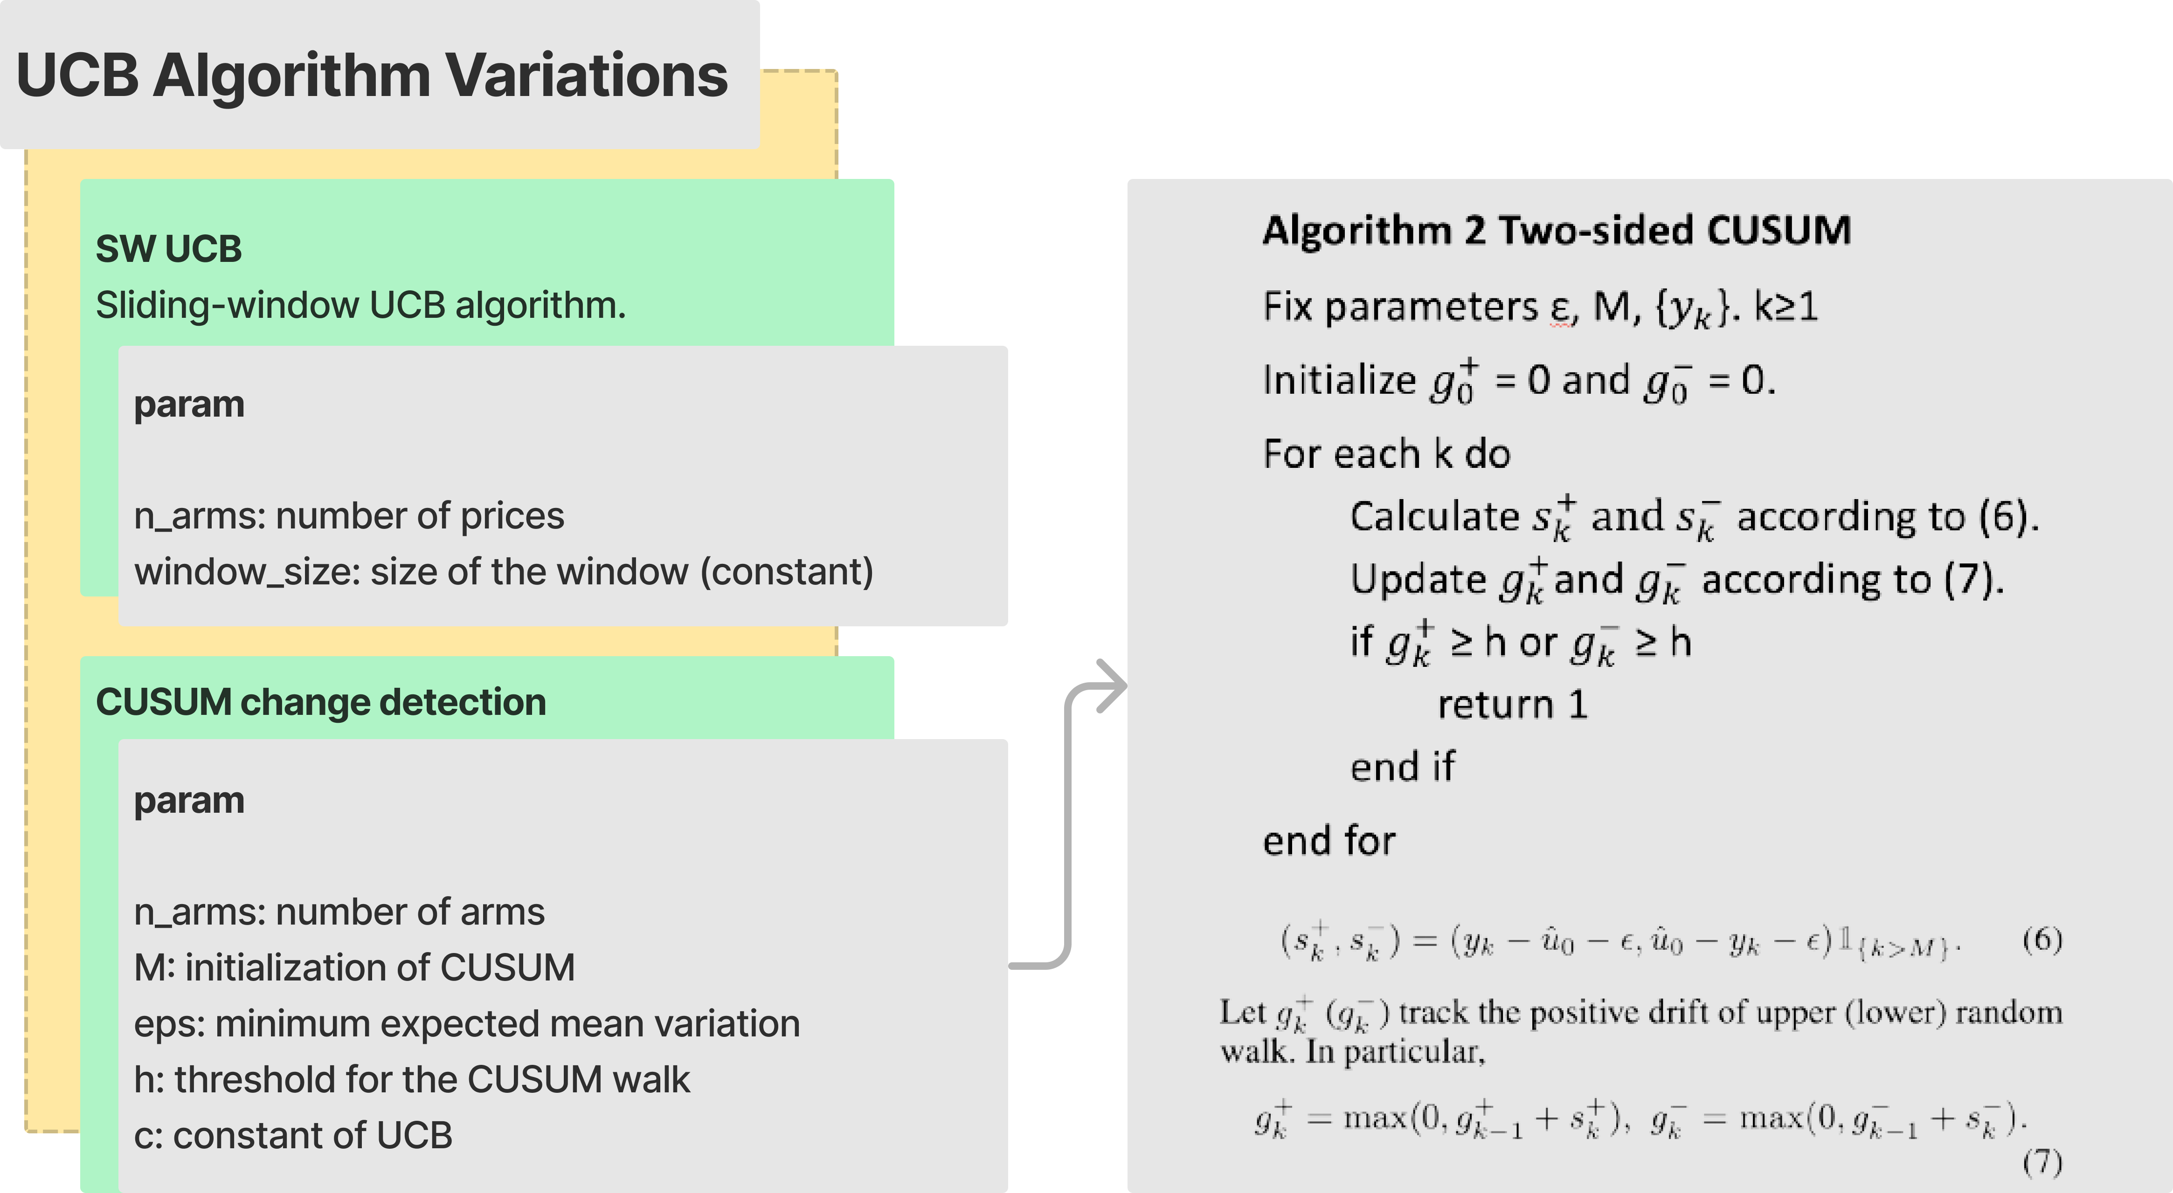
*Fang Liu and Joohyun Lee and Ness Shroff
Notes:
We do not go into details for the sliding windows, the idea is simply that variables such as the average are calculated over a fixed-length time window of 90 days (quarter). Instead, we talk about the UCB with a change detection algorithm that we have implemented.
The idea is that we have a change detection algorithm for each arm for each product. When a change is detected, we reset UCB associated with that product.
The algorithm we chose for change-detection is called CUSUM and we can see it here on the right. CUsUM (or cumulative sum control chart) involves the calculation of a cumulative sum and when the value of the sum g exceeds a certain threshold value, a change is detected.
In particular, our algorithm aims to understand if the conversion rates are changing. The algorithm collects M data n_buy/n_cliks than compute hat u_0 which would be the mean conversion rate. Then, at each iteration we make the difference between y_k and hat u_0 and we take out from this distance from the epsilon, which states for the variability. At each step, we sum all these s_k up they overcome a setted threashold h. We do this procedure both for the left and right tail.

Slide 52
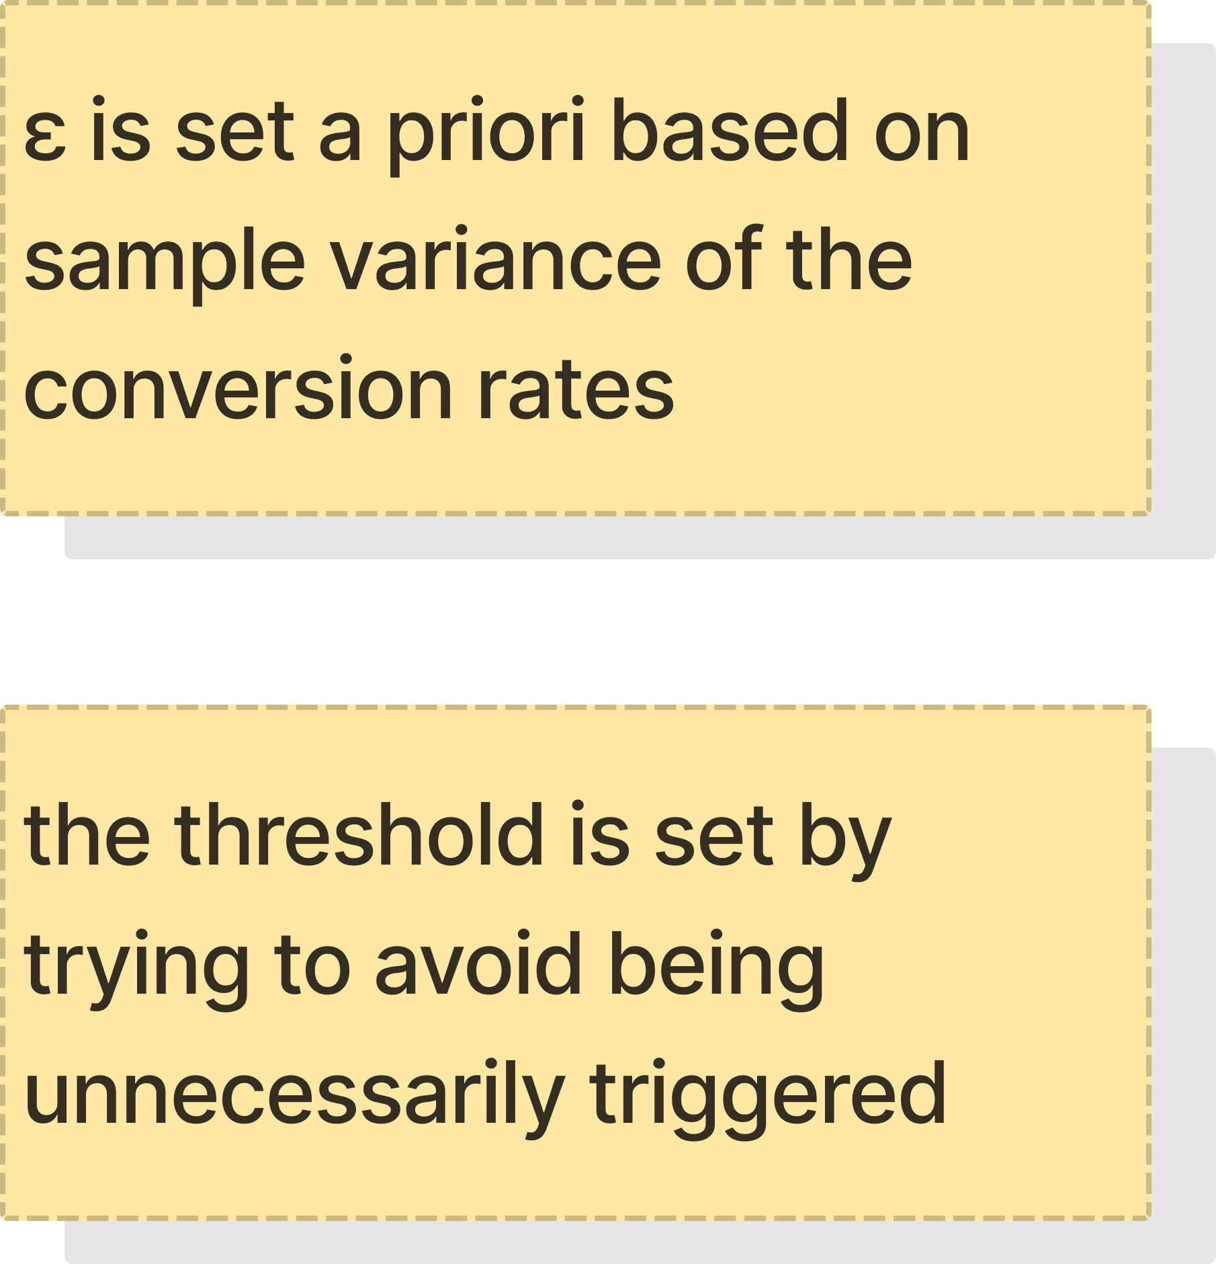
CUSUM ALGORITHM – threshold definition
Notes:
the threashold is set to avoid false positives: in fact when we detect a change we reset ucb and loose all information. this should only be done if we have a very high confidence because it has a high cost if we are wrong.

Slide 53
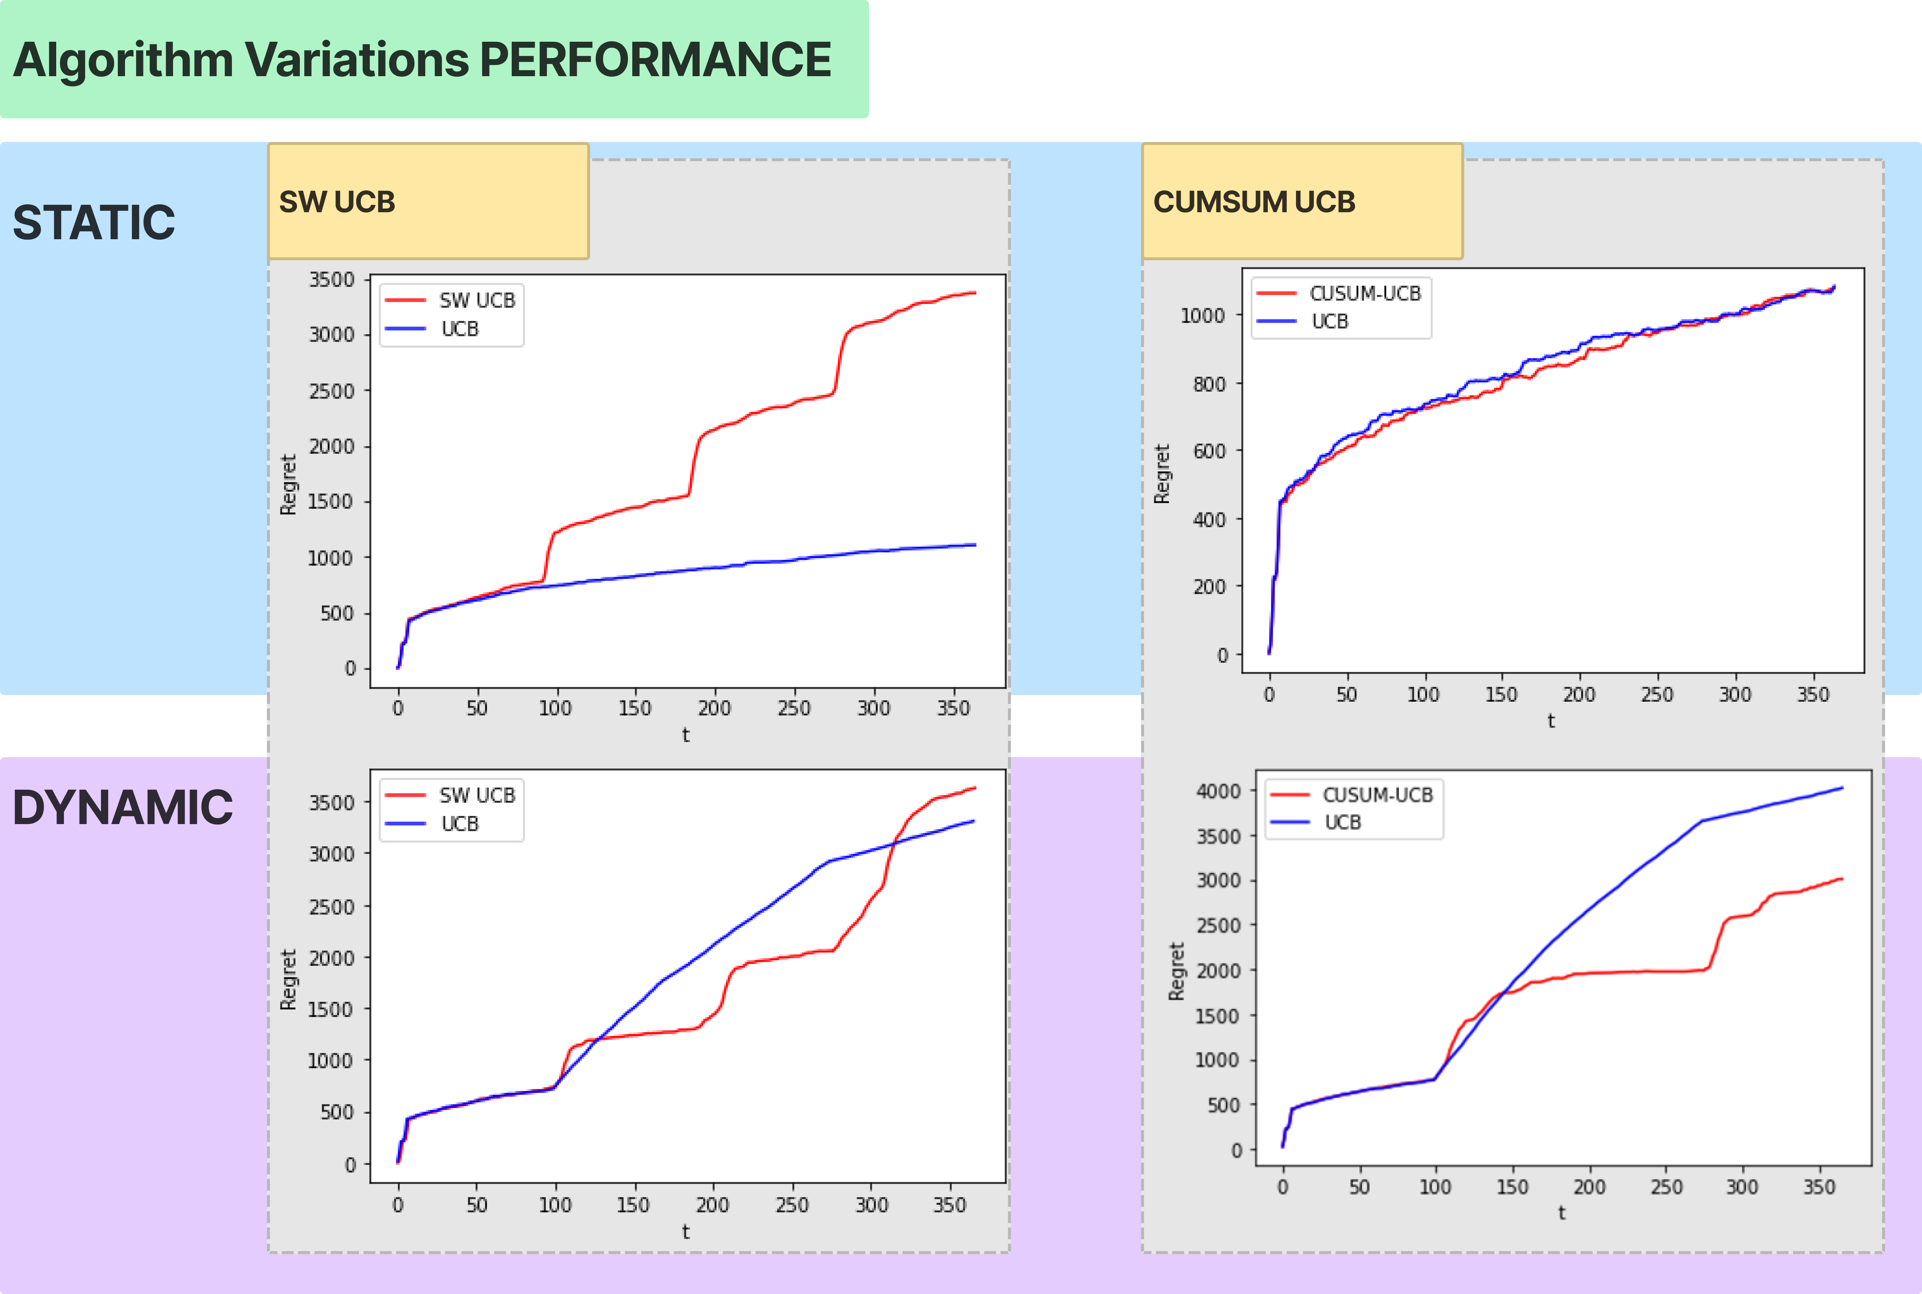

Slide 54
RESULTS STEP 6 – Static [100 users]
Total expected reward over 365 days and its standard deviation considering 20 experiments
SW-UCB 40007 138
CUSUM-UCB 42197 81
-----------------------------------------------
Total expected regret over 365 days and its standard deviation considering 20 experiments
SW-UCB 3300
CUSUM-UCB 1109
-----------------------------------------------
Average expected reward per round over 365 days and its standard deviation between the rounds considering 20 experiments
SW-UCB 110
CUSUM-UCB 115
-----------------------------------------------
Average expected regret per round over 365 days and its standard deviation between the rounds considering 20 experiments
SW-UCB 9.04
UCB CUSUM-UCB 3.04

Slide 55
Dynamic [100 users]
Total expected reward over 365 days and its standard deviation considering 10 experiments
SW-UCB 40018 156
CUSUM-UCB 40800 806
-----------------------------------------------
Total expected regret over 365 days and its standard deviation considering 10 experiments
SW-UCB 3810
CUSUM-UCB 3045
-----------------------------------------------
Average expected reward per round over 365 days and its standard deviation between the rounds considering 10 experiments
SW-UCB 110
CUSUM-UCB 112
-----------------------------------------------
Average expected regret per round over 365 days and its standard deviation between the rounds considering 10 experiments
SW-UCB 10.90
CUSUM-UCB 8.61

Slide 56
Step 7 – Context generation
We assume that we can record all the features on the website and that we can set a different price for each user’s class [position-based prices and discounts for the premium members)
New E-commerce structure: we consider each context separately
Every 14 days, we test if splitting a feature is worth it or not through the condition:

Slide 57
Step 7 – Context generation

Slide 58
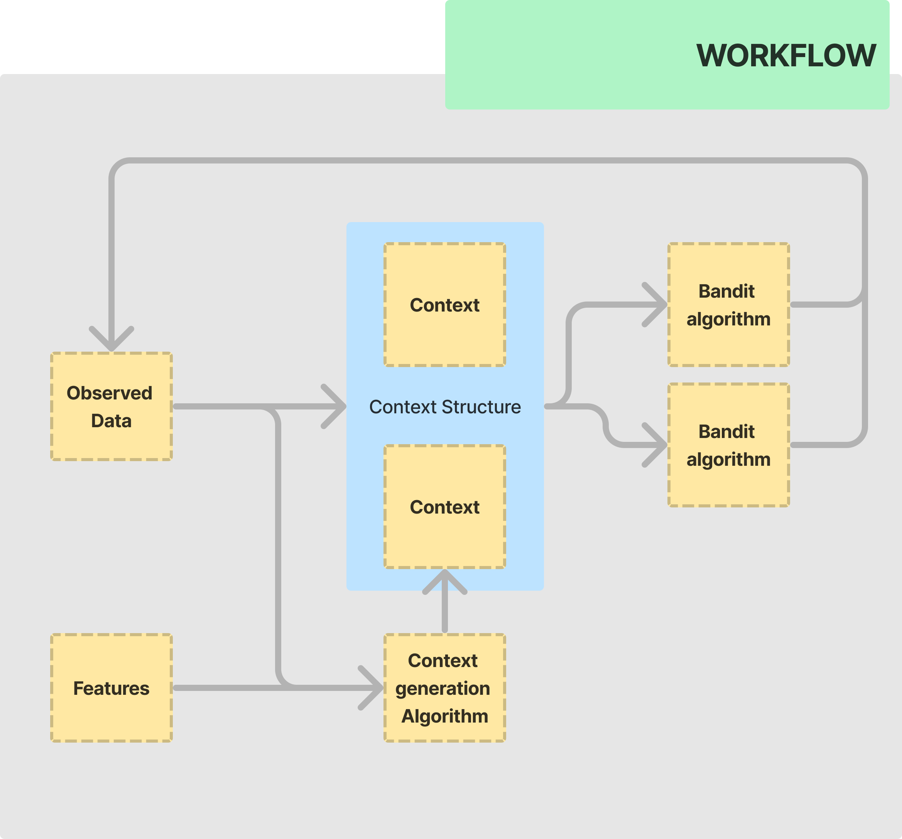
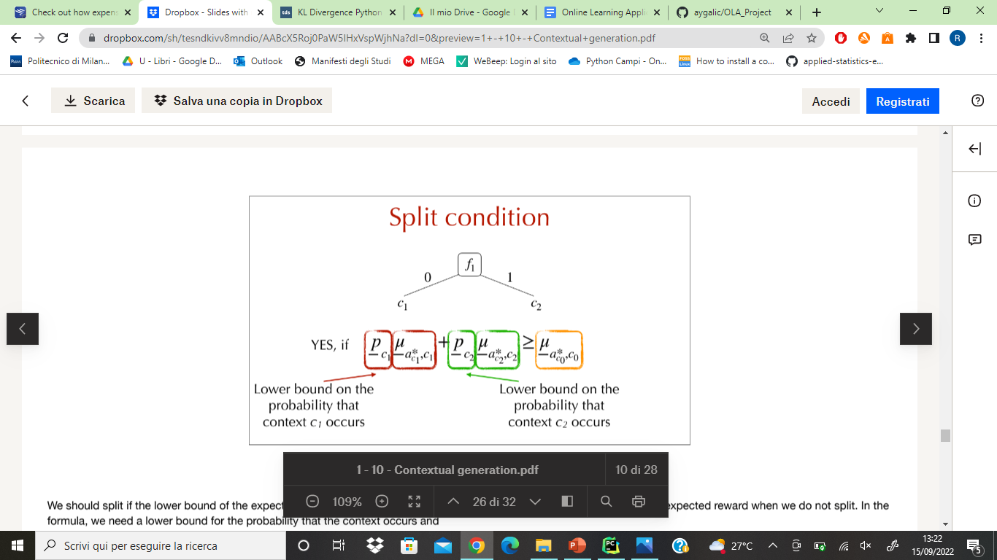
Split Condition
Based on

Slide 59
Simulation of the context generation for TS ​
one class
Italian
Non-Italian
$$μ_{0}=1186$$
$$p_{c1}∗μ_{c1}+p_{c2}∗μ_{c2}=1928$$
SPLIT F1 MAKES SENSE ​

Slide 60
Simulation of the context generation for TS ​
Italian
Non-Italian
Member
Non member
$$μ_{0}=1928$$
SPLIT F2 DOES NOT MAKE SENSE ​
$$p_{c1}∗μ_{c1}+p_{c2}∗μ_{c2}=1903$$

Slide 61
Simulation of the context generation for TS ​
Period 0​ mu_c0_ts= [[1185.7462826575595, 0], [0, 0]]​ period 1​ mu_c0_ts= [[1185.7462826575595, 0], [1928.443288310946, 0]]​ p_c1*mu_c1 + p_c2*mu_c2= 1928.443288310946​ --- SPLIT F1 MAKES SENSE ---​ period 2​ mu_c0_ts= [[1185.7462826575595, 0], [1928.443288310946, 1903.8843444854774]]​ p_c1*mu_c1 + p_c2*mu_c2= 1903.8843444854774​ --- SPLIT F2 DOESN'T MAKE SENSE (we consider only f1)---​ period 3​ mu_c0_ts= [[1185.7462826575595, 0], [1864.4348796352126, 1903.8843444854774]]​ p_c1*mu_c1 + p_c2*mu_c2= 1864.4348796352126​ --- SPLIT F1 MAKES SENSE ---​ Period 4​ mu_c0_ts= [[1185.7462826575595, 0], [1864.4348796352126, 1940.9036865966405]]​ p_c1*mu_c1 + p_c2*mu_c2= 1940.9036865966405​ --- SPLIT F2 MAKES SENSE (together with f1)---​ Period 5​ mu_c0_ts= [[1185.7462826575595, 0], [1864.4348796352126, 2313.224688074132]]​ p_c1*mu_c1 + p_c2*mu_c2= 2313.224688074132​ SPLIT F2 MAKES SENSE (together with f1)---

Slide 62
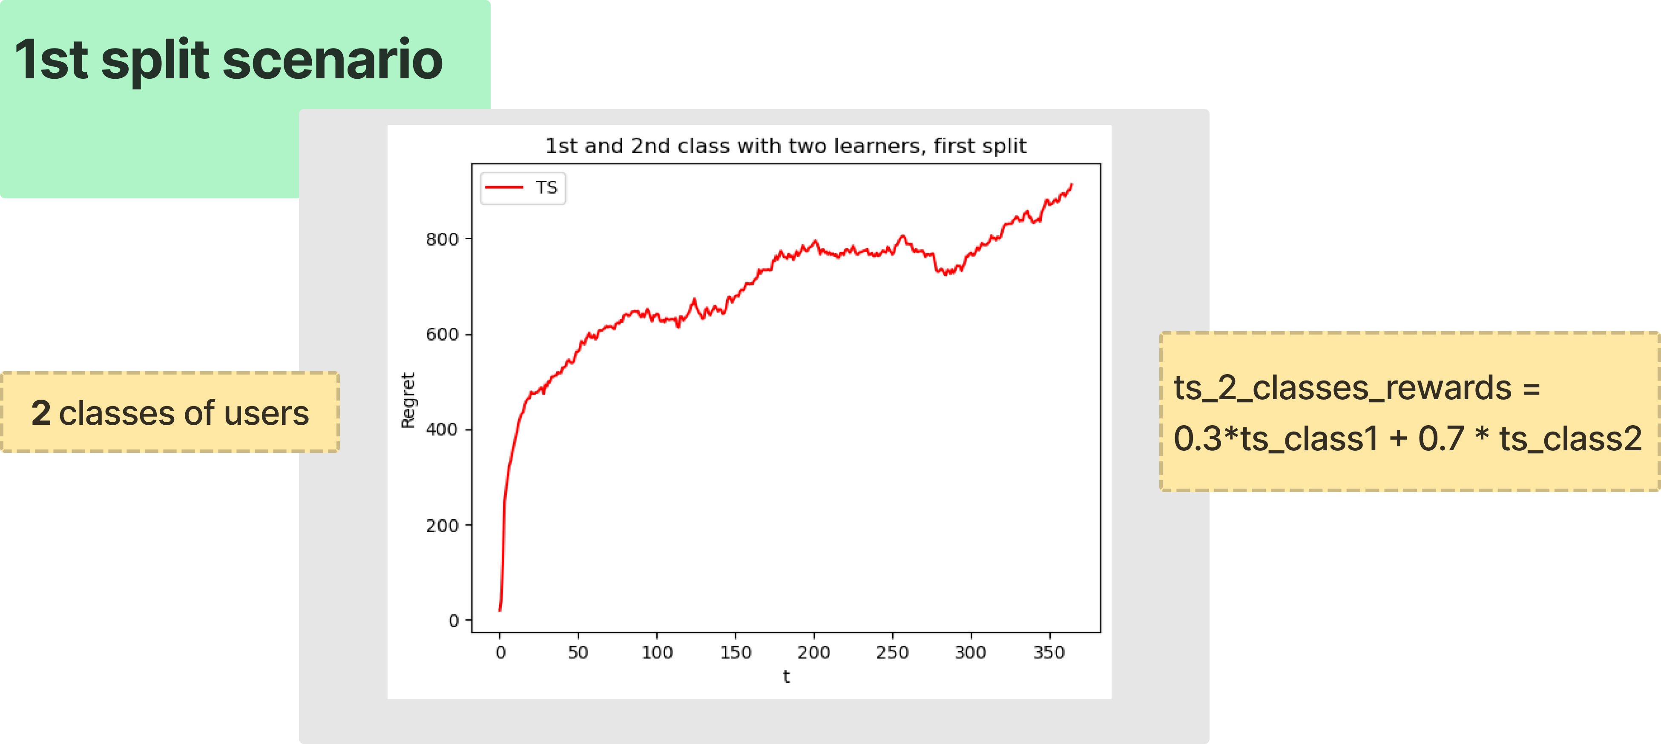

Slide 63
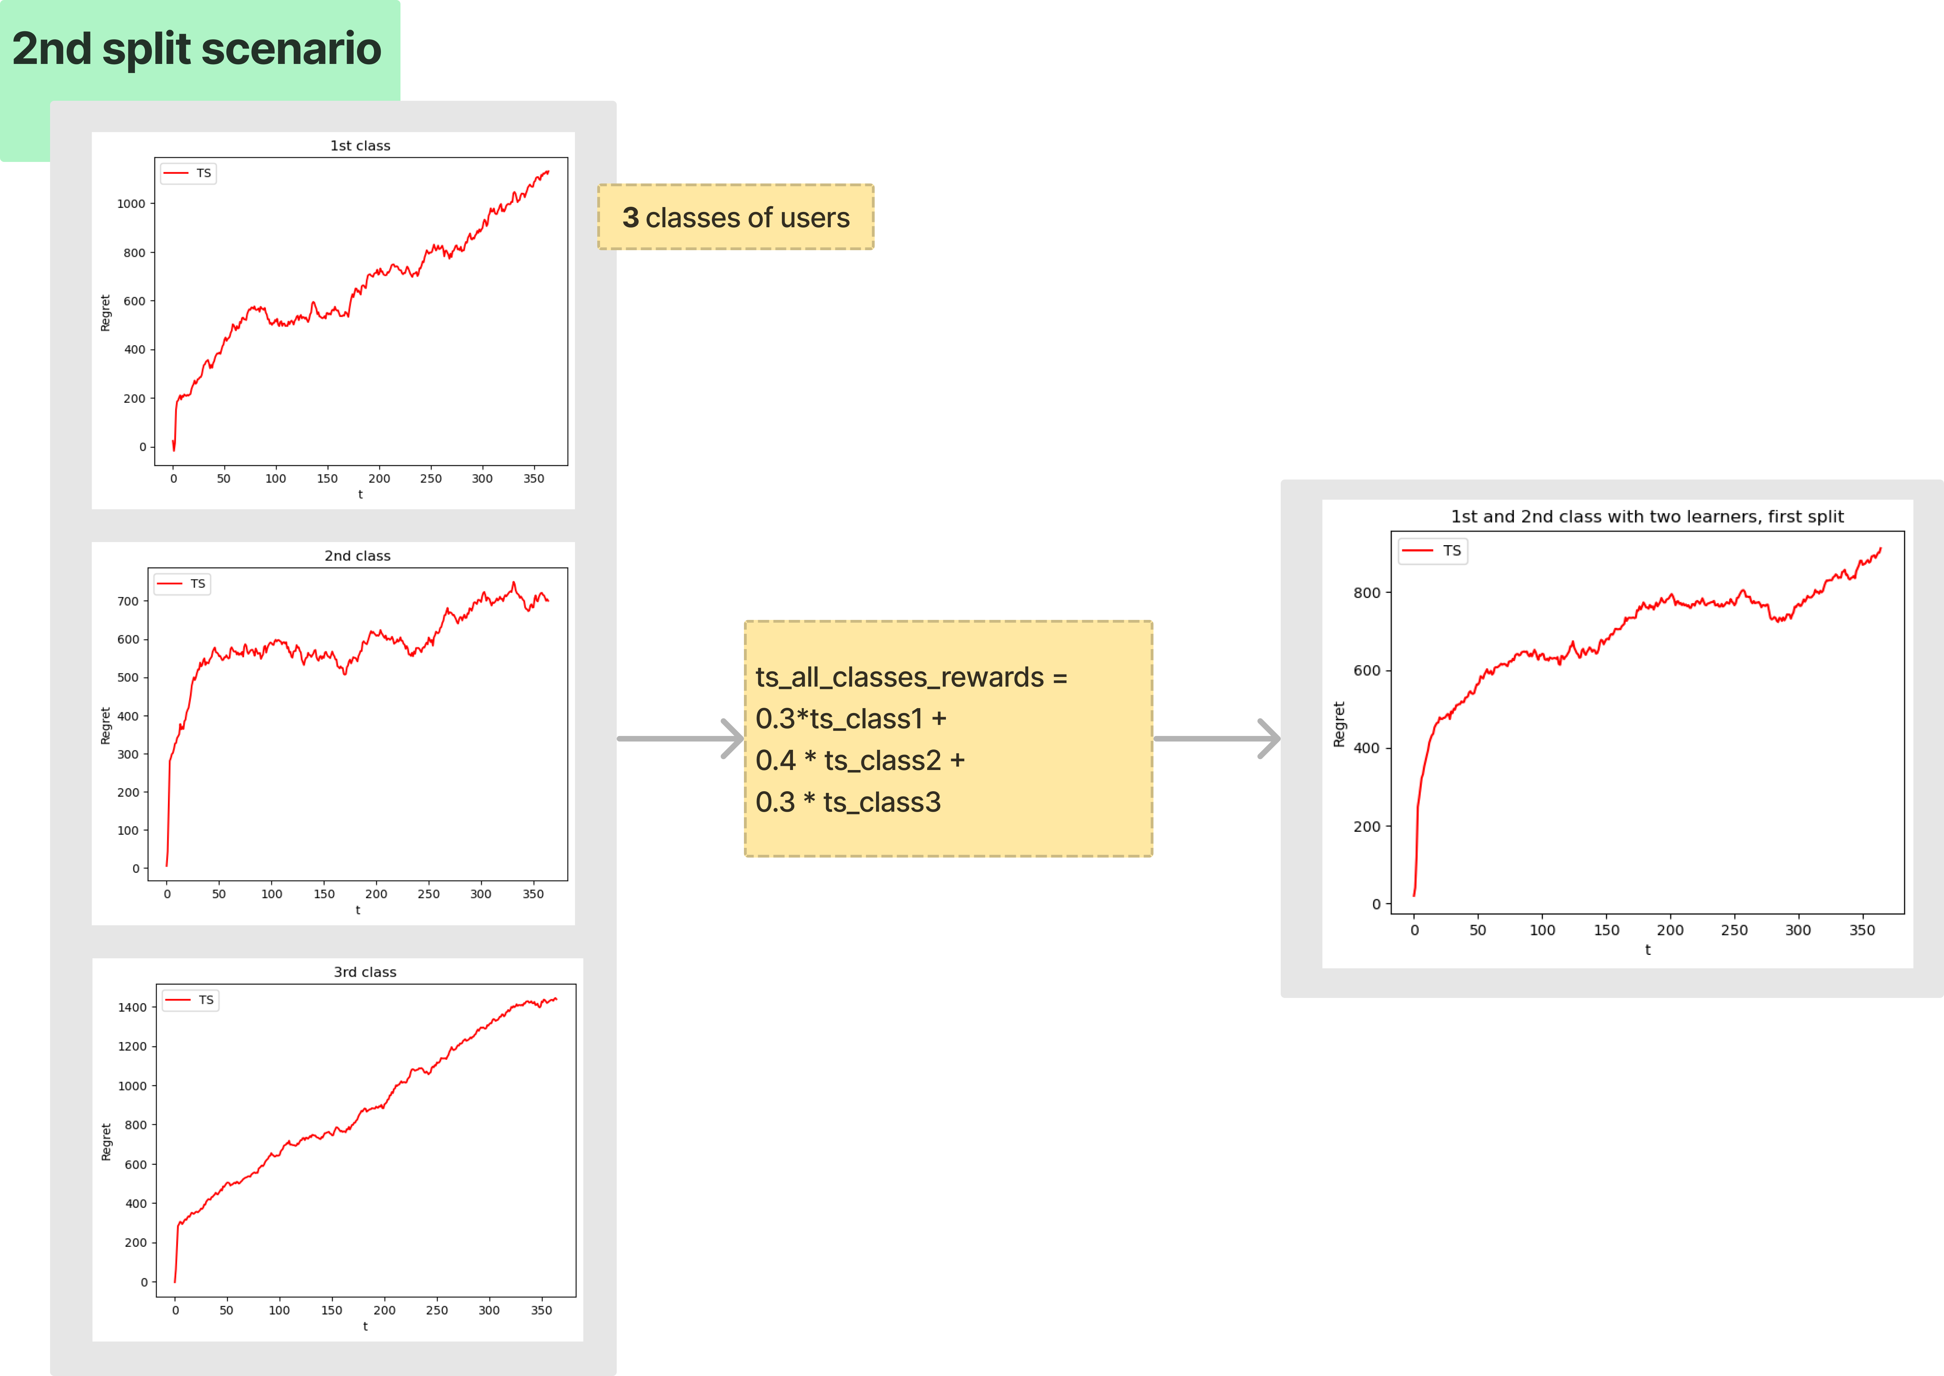
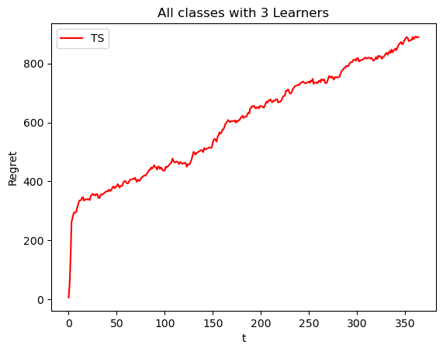

Slide 64
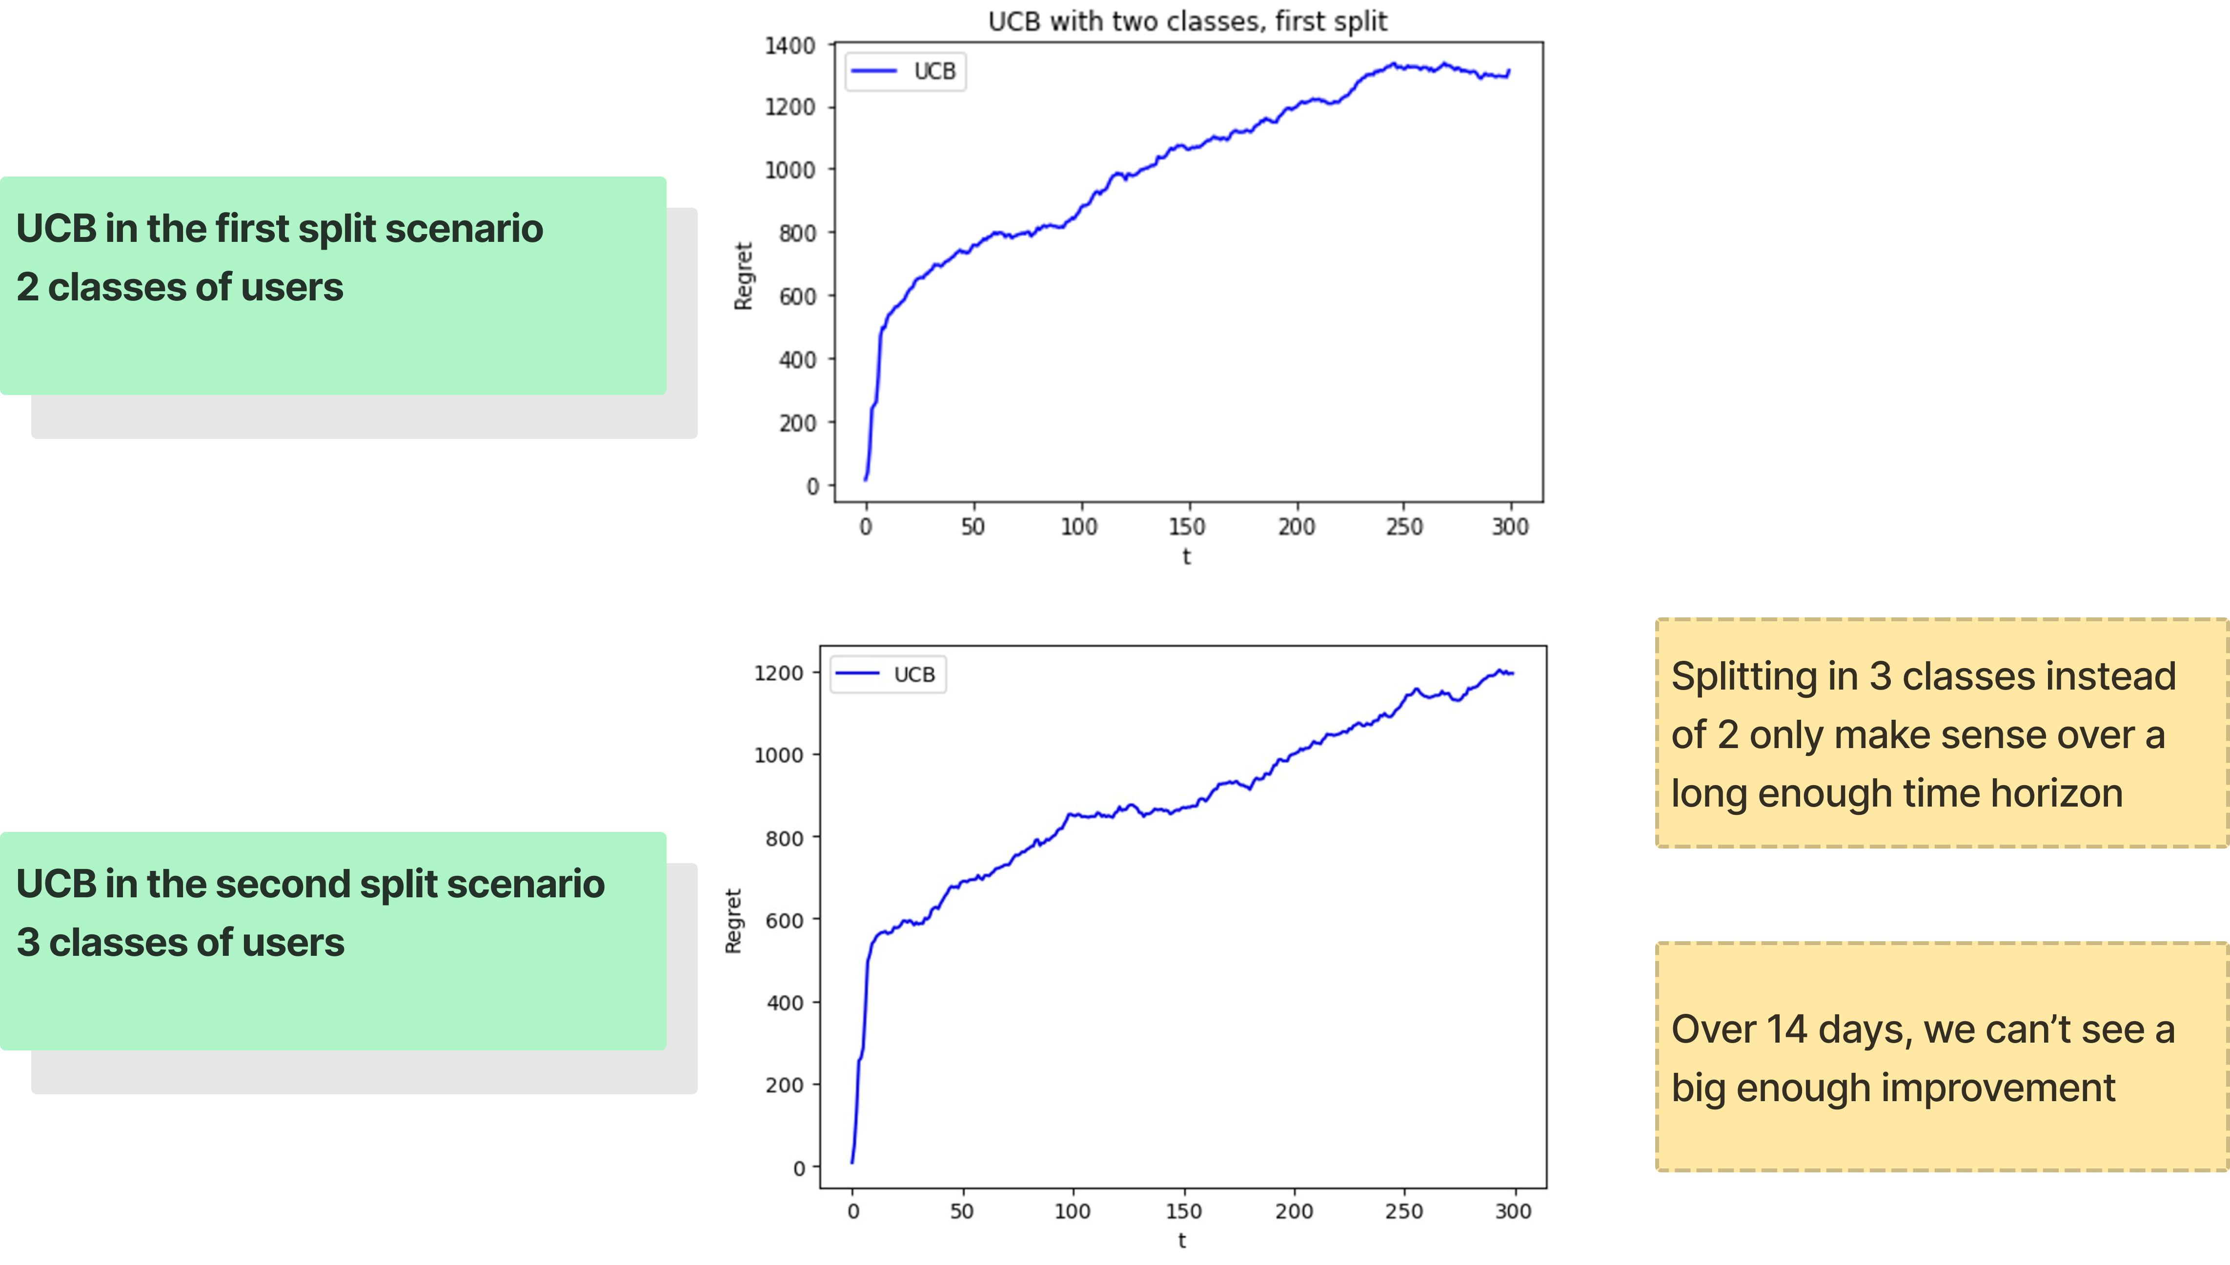
Notes:
splitting

Slide 65
Results step 7
Considering the optimal solution per round: 125.66
Thomson Sampling
Average expected reward per round on 365 days over 10 runs: 122.81
Average expected regret per round in 365 days over 10 runs : 2.85
Average total regret in 365 days over 10 runs: 1040
Average total reward in 365 days over 10 runs: 44828 with a standard deviation of 1484 between the experiments
UCB
Average expected reward per round on 365 days over 10 runs: 121.68
Average expected regret per round in 365 days over 10 runs : 3.97
Average total regret in 365 days over 10 runs: 1193
Average total reward in 365 days over 10 runs: 36506 with a standard deviation of 423 between the experiments

Slide 66
Conclusion
Thompson Sampling and UCB are efficient algorithm to deal with pricing optimization problems
Competent under uncertainty
In general out-perform random choices and greedy algorithms
Split model being superior
Resilient in not stationary condition (for little variation)

Slide 67

Thank You
Images from Pau Barbaro on blush.design
Images by pch.vector on Freepik

